Slide 1
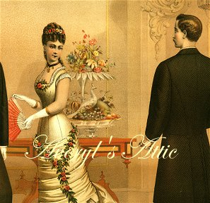
The Victorian Period
by
Mariah Wilkinson

Slide 2
Timeline
1837- 1838 Charles Dickens publishes Oliver Twist in period form
1840 Margaret Fuller helps found The Dial, a U.S. Transcendentalist journal
1852 Sojourner Truth delivers her “Ain’t I A Women?” speech in Akron, Ohio
1859 Charles Darwin publishes On The Origin Of Species By Means Of National Selection

Slide 3
Timeline continued…
1865 Lewis Carroll publishes Alice’s Adventure in Wonderland
1868- 1869 Louisa May Alcott publishes Little Women
1884 Mark Twain’s Adventures of Huckleberry Finn appears
1887 Arthur Conan Doyle introduces the world to Sherlock Holmes with A Study in Scarlet
1990 L. Frank Baum publishes The Wonderful Wizard of Oz

Slide 4
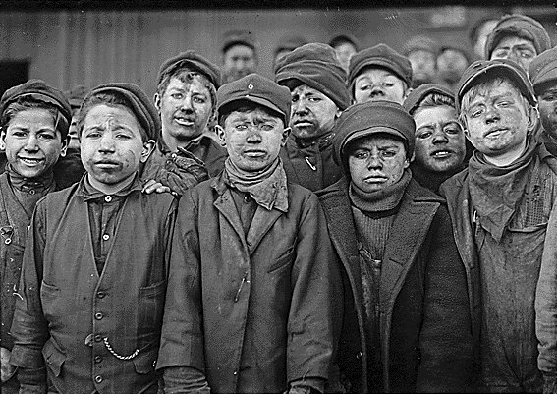
Poor Working Conditions
The government investigated factories in London.
They found that children had been mangled in the machinery when thee feel asleep from working all day on 12 hour shifts.
They also discovered that young girls and boys were hauling coal through narrow mine tunnels.
The children worked shifts so long that they had only seen the sun on Sundays.

Slide 5
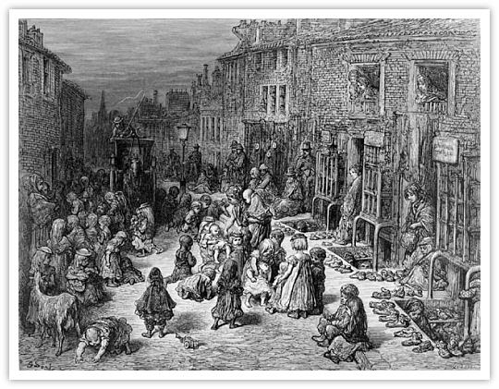
The Potato Famine
In 1845- 1849, in Ireland, the potato blight caused a famine
It killed a million people and forced two million people to emigrate.
Some moved to England where they lived ten to twelve in a single room.
In the slums, there was two toilets for every 250 people.

Slide 6
Pollution and Filth
Nearly two million people lived in London during the 1840s.
The rapid growth of cities usually caused them to be filthy and disorderly.
Manchester and Liverpool, two of the commercial and industrial cities, expanded very quickly.
The Thames River was polluted with sewage, industrial waste, and the drainage form the graveyards.

Slide 7
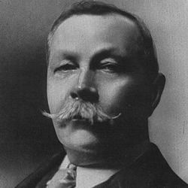
Sir Arthur Conan Doyle

Slide 8
About
born on May 22, 1859, in Edinburgh, Scotland
After Arthur reached his ninth birthday, the wealthy members of the Doyle family offered to pay for his studies where for seven years he had to go to a Jesuit boarding school.
It was during these difficult years at boarding school, that Arthur realized he also had a talent for storytelling.
By 1876, he graduated at the age of 17.

Slide 9
A Study in Scarlet
The first of four crime novels
It didn't really take hold of the public's imagination until Strand magazine started publishing a series of short stories known as “Adventures of Sherlock Holmes”.
In1887, Sherlock Holmes was first introduced to the world.
From 1891 to 1893, Strand published stories featuring Holmes and Watson, that were also followed by the public.

Slide 10
A Sign of Four
The second of four crime novels
Published in 1890

Slide 11
Hound of the Baskervilles
third of four crime novels
it is set largely on Dartmoor in Devon in England's West Country
tells the story of an attempted murder inspired by the legend of a fearsome, diabolical hound.

Slide 12
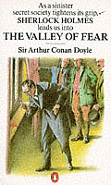
The Valley of Fear
the last of the crime novels
It was first published in serial form in the Strand Magazine from September 1914 to May 1915.

