Slide 1
The Romantics 1798-1832
Daniel Dudley

Slide 2
Literary Events
Romantic period started with the French revolution in 1789 and ended with the parliamentary.
1786 Robert burns published poems chiefly in the Scottish dialect .
In 1826 Jane austin publishes pride and prejudice.

Slide 3
Poets of the romantics
This era has been mostly often. identified with six poets ….

Slide 4
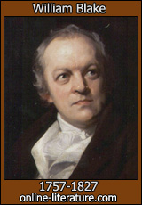
WILLIAM BLAKE (28 November 1757 – 12 August 1827) was an English poet, painter, and printmaker. Largely unrecognised during his lifetime, Blake is now considered a seminal figure in the history of both the poetry and visual arts of the Romantic Age.

Slide 5
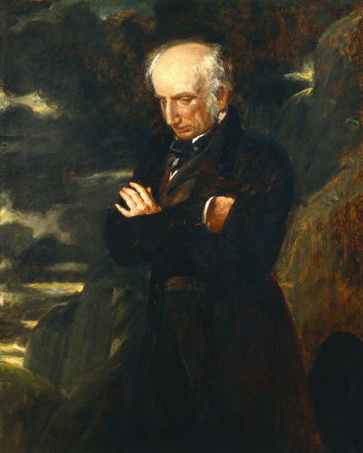
William wordsworth (7 April 1770 – 23 April 1850) was a major English Romantic poet who, with Samuel Taylor Coleridge, helped to launch the Romantic Age in English literature with the 1798 joint publication Lyrical Ballads.

Slide 6
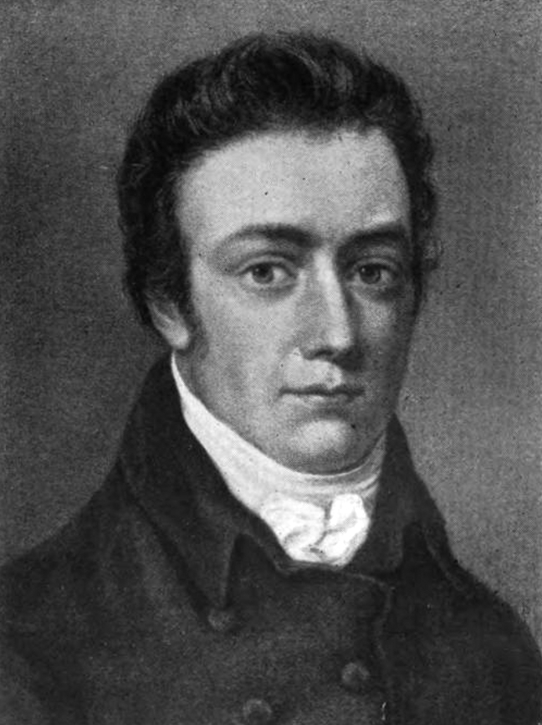
Samuel Taylor 21 October 1772 – 25 July 1834) was an English poet, Romantic, literary critic and philosopher who, with his friend William Wordsworth, was a founder of the Romantic Movement in England and a member of the Lake Poets.

Slide 7
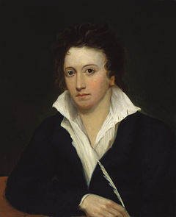
Percy shelly August 1792 – 8 July 1822) was one of the major English Romantic poets and is critically regarded among the finest lyric poets in the English language. Shelley was famous for his association with John Keats and Lord Byron. The novelist Mary Shelley was his second wife.

Slide 8
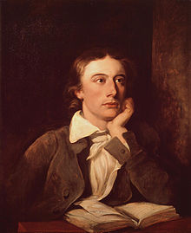
John Keats. 31 October 1795 – 23 February 1821) was an English Romantic poet.

Slide 9
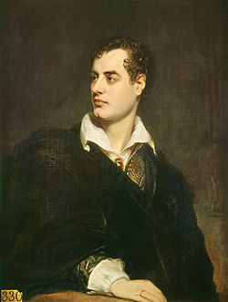
Lord byron (22 January 1788 – 19 April 1824), commonly known simply as Lord Byron, was a British poet and a leading figure in Romanticism

Slide 10
Sir walter scott
(15 August 1771 – 21 September 1832)
He was a Scottish historical novelist, playwright, and poet, popular throughout much of the world during his time.

Slide 11
Scott was the first English-language author to have a truly international career in his lifetime,^{[1]} with many contemporary readers in Europe, Australia, and North America. His novels and poetry are still read, and many of his works remain classics of both English-language literature and of Scottish literature.

Slide 12
His famous titles include
Ivanhoe
Rob Roy
The Lady of The Lake
Waverley
The Heart of Midlothian
The Bride of Lammermoor.

Slide 13
Backround info
Scott began studying classics at the University of Edinburgh in November 1783, at the age of only 12, a year or so younger than most of his fellow students
Born in College Wynd ^{[2]} in the Old Town of Edinburgh in 1771, the son of a solicitor, Scott survived a childhood bout of polio in 1773 that left him lame

Slide 14
More backround..
To cure his lameness he was sent in 1773 to live in the rural Borders region at his grandparents' farm at Sandyknowe, adjacent to the ruin of Smailholm Tower, the earlier family home.

Slide 15
citations
http://www.wikipedia.org/

