Slide 1
THE Modern era
BY BRANDTIZZLE

Slide 2
WWII
was a global military conflict lasting from 1939 to 1945

Slide 3
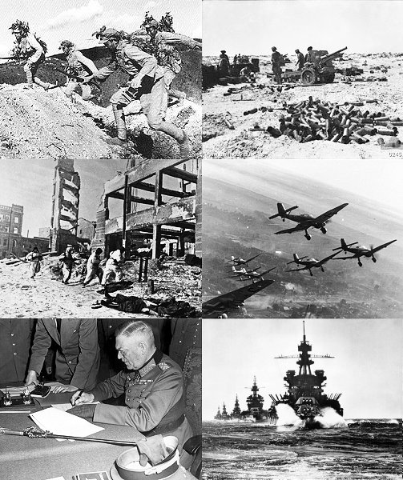
WWII

Slide 4
WWII
When Hitler's army invaded Poland in 1939 GB and France took arms against them

Slide 5
WWII THE END
In the 1940’s most of Great Britain's colonies had declared independence

Slide 6
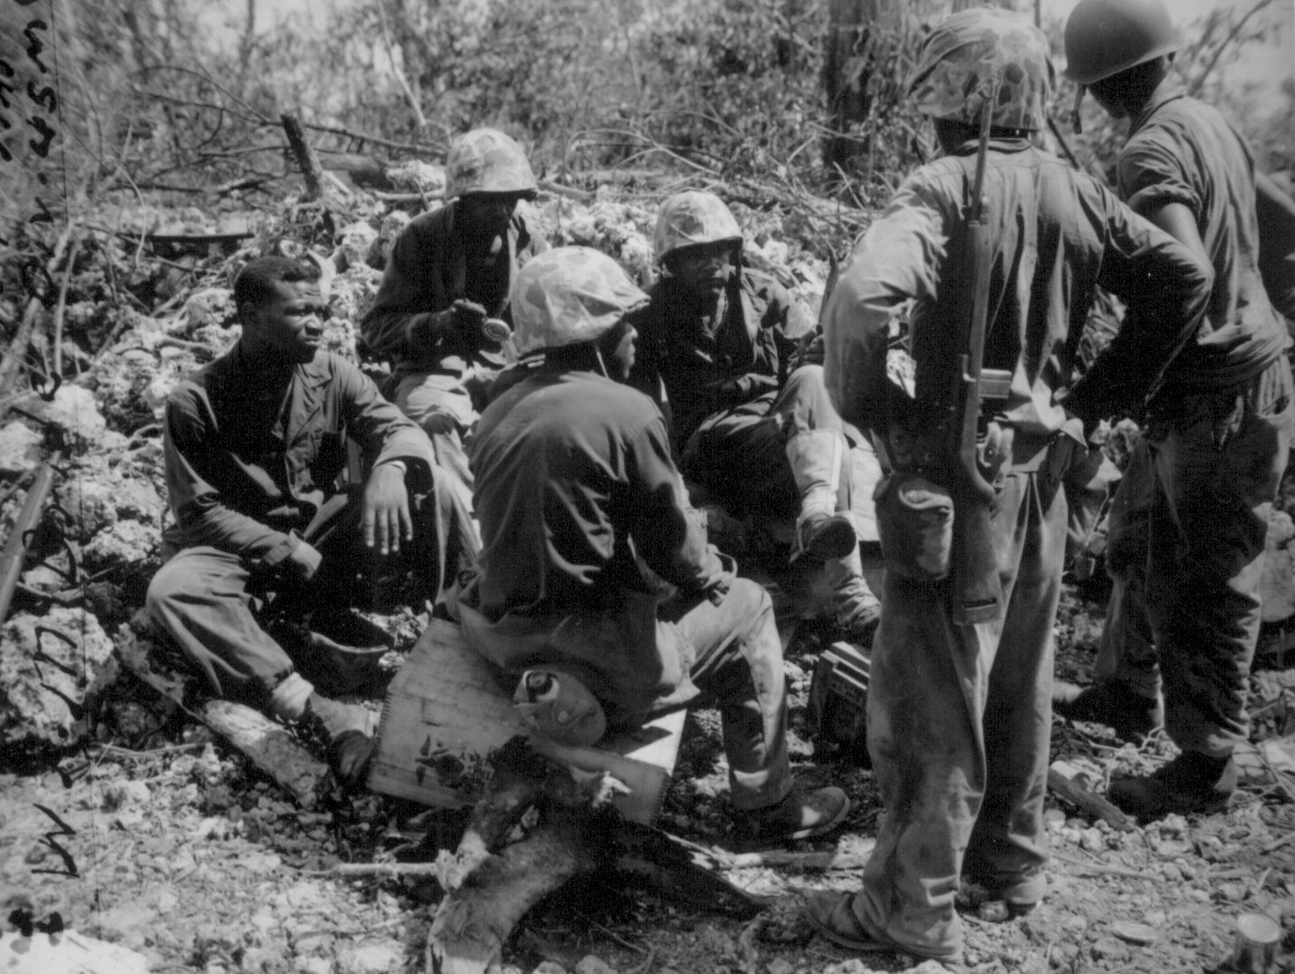
WWII chillin

Slide 7
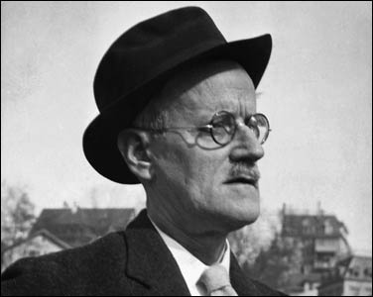
James joyce

Slide 8
James Joyce
His Ulysses baffled readers and challenged aspiring writers. It also revolutionized 20th century fiction

Slide 9
James Joyce
He fled Ireland into self-imposed exile late in 1904, taking with him Nora Barnacle, a young woman from Galway who was working as a hotel chambermaid in Dublin when Joyce met her earlier that year.

Slide 10
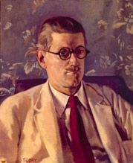
James Joyce

Slide 11
James Joyce
The book consists of 18 chapters, each covering roughly one hour of the day, beginning around 8 a.m. and ending some time after 2 a.m. the following morning. Each chapter employs its own literary style, and parodies a specific episode in Homer's Odyssey. Furthermore, each chapter is associated with a specific colour, art or science, and bodily organ.

Slide 12
citation
http://www.time.com/time/time100/artists/profile/joyce3.html
http://en.wikipedia.org/wiki/James_Joyce

