Slide 1
The Middle ages
Karlee Lindsey

Slide 2
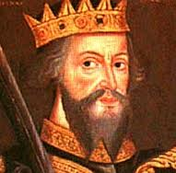
William the conqueror
He was an illegitimate child and was promised the English throne. He didn’t get it, so he sailed across the English Channel with his enormous army.

Slide 3
Taxes
One of his great administrative feats was an inventory of nearly every piece of property in England. Land, cattle, buildings in the Domesday Book. Taxes were based on what people owned.

Slide 4
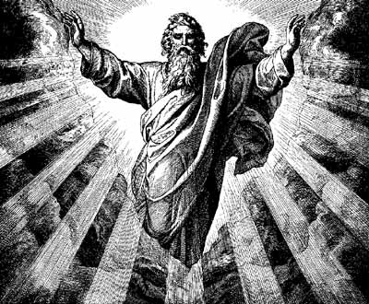
Feudalism
He brought this new social system. Also known as a caste system, property system, and military system.
Based on a religious concept of rank. God as the supreme overlord.

Slide 5
The system didn’t always work.
But it did carry with it a sense of form and manners that influenced all aspects of the life, art, and literature of the Middle Ages.

Slide 6
The battle of hastings
1066
Harolds group was attacked, he died.

Slide 7
Chrétien de Troyes
Chrétien de Troyes was probably the greatest medieval writer of Arthurian romances.

Slide 8
Chrétien de Troyes
Chrétien de Troyes was a French poet and trouvère who flourished in the late 12th century
Chrétien's writing was very popular, as evidenced by the high number of surviving copies of his romances and their many adaptations into other languages.

Slide 9
Romances
His narrative romances, composed c.1170–c.1185 in octosyllabic rhymed couplets, and they include Érec et Énide; Cligès; Lancelot, le chevalier de la charette; Yvain, le chevalier au lion; and Perceval, le conte del Graal.

Slide 10
His work on Arthurian subjects represents some of the best regarded of medieval literature. His use of structure, particular in Yvain, the Knight of the Lion, has been seen as a step towards the modern novel.

Slide 11
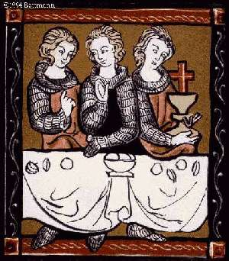
QUOTES
"Through their kisses and caresses they experienced a joy and wonder the equal of which has never been known or heard of. But I shall be silent...; for the rarest and most delectable pleasures are those which are hinted at, but never told."
— Chrétien de Troyes

