Slide 1
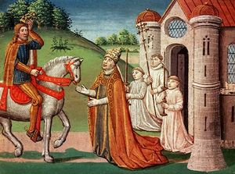
The Middle Ages
By Mariah Wilkinson

Slide 2
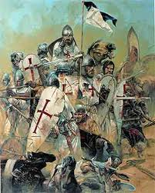
The Great Happening: The Crusades
The Crusades (1095- 1270) were series of holy wars waged by European Christians against Muslims. In 1095, Pope Urban II sent out for help of Christians. He encouraged them to start a war against Muslims that were living in Jerusalem and other place in the Middle east. This cause many military expeditions that are known as the crusades. For 200 years, Crusaders had set out to take over Jerusalem. They had slaughtered many Jews and Muslims and even little children. The Children’s Crusades was organized in the year 1212. The European didn’t manage to keep Jerusalem. The carnage that the crusades caused was enormous but Europe benefited from the contact with the middle eastern civilization. They were exposed to eastern mathematics, astronomy, architecture and crafts. This made life possible.

Slide 3
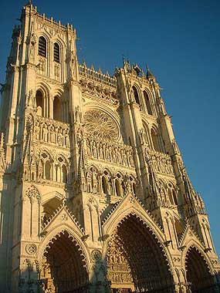
The Great Happenings: The Martyrdom of Thomas à Becket
Thomas à Becket (1118- 1170), a Norman, had came into power as chancellor with the help of his friend King Henry II. All the Christians had belonged to the catholic church, even King Henry was a vassal. The Pope, the head of the church and god’s representative, has a fair amount power and could control most of the higher powered rulers. King Henry hoped to win in the arguments that took place in the church by appointing Thomas archbishop of Canterbury. Unfortunately, Thomas took the side of the Pope most often then the King. This made the king very angry. In the December of 1170, King Henry was ranting through his castle speaking about the matter out loud to himself asking if someone could “rid him of this turbulent priest”. Four men over hear this and went off to find Thomas. These four knights murdered Thomas in his own cathedral. The public was outraged and created a set back that caused a setback for the monarchy. This setback caused all types of liberties and corruption that the state could not make right. The church did have the positive effect of fostering cultural unity and continued to be the center of learning. Latin remained the international language of educated Europeans. The Pope remains the leader.

Slide 4
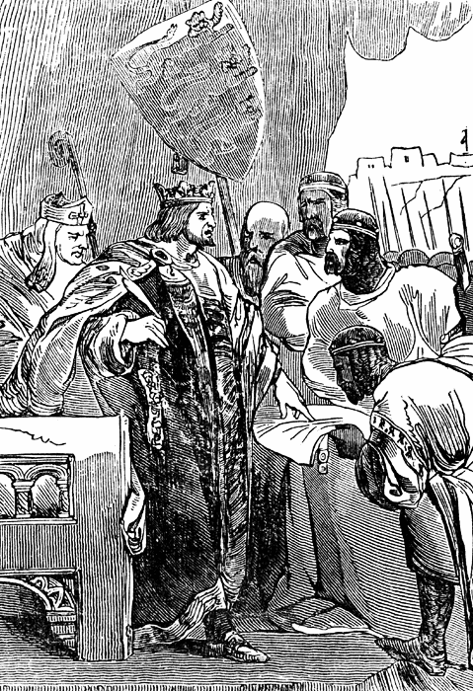
The Great Happenings: The Magna Carta
The event that brought back the democratic tendencies in England was the Magna Carta. The Magna Carta (Great Charter) was signed in Runnymede in 1215 by King John. Although King John signed it, he did not want to. He was forced to by the English Barons which meant for the defeat for central papal power. The Barons had no interest in the rights of the people. The Magna Carta soon became the basis of English constitutional law. The rights as trial by jury and legislative taxation were established.

Slide 5
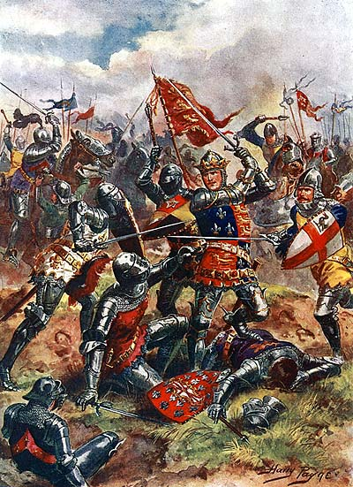
The Great Happenings: The Hundred Years’ War
The Hundred Years’ war or the first national war was fought between England and France. This war was militarily unsuccessful for England but played a role in the development of British national consciousness. The knights in shining armor did not represent England after the war was over in which the green clad yeoman (small landowners) took representation. The yeomen had formed small English armies in France. These yeomen had long arrows that could pierce the knights armor when they shot them over the castle walls. The yeomen had now become the dominant force. The idea of chilvry had died in society but lived on in stories.

Slide 6
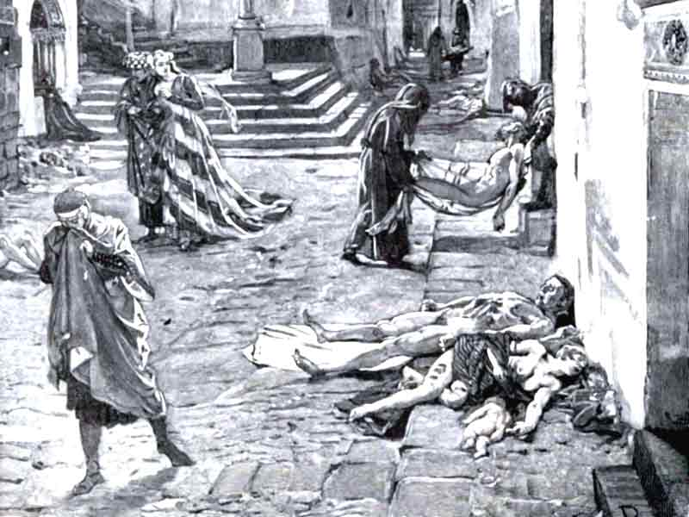
The Great Happenings: The Black Death
The Black Death or Bubonic plague (1348- 1349) was another part of feudalism. The plague very contagious and unimaginably horrifying. It had spread throughout England from the fleas of infected rats. Some of the symptoms of the plague were the blotches ( the most horrific), the hardening of the glands underneath the armpits of in the groin (swellings). These swellings cause tumors in peoples bodies. Death Delirium and insanity was running ramped in the towns and it stunned and destroyed the life and faith of the world. The plague also brought the nations population down by a whole third of what it was. This caused a shortage in labor and gave power to the low class citizens over their overlords.

Slide 7
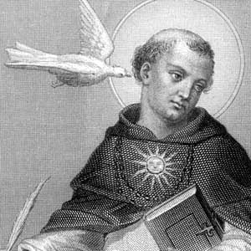
Thomas Aquinas (1224- 1274)

Slide 8
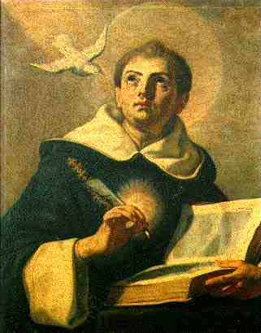
About Thomas
Born 1224 in Roccasecca, Naples, Italy and died (illness) March 7, 1274 in Monastery of Fossanova, Sonnino, Italy. This Italian Dominican theologian scholastic philosopher was of noble descent. He almost was an ally to several of the royal houses of Europe.

Slide 9
About Thomas Continued…
Thomas studied for six years at the University of Naples. While there he came under the influence of the Dominicans, who were trying to enlist within their ranks the most able young scholars, in disregard of his family, he assumed the habit of St. Dominic his 17th year.

Slide 10
About Thomas Continued…
As a theologian, he was responsible in his two masterpieces, the Summa theologiae and the Summa contra gentiles. Also, as a poet, Thomas wrote some of the most amazing hymns. Even the other theologians didn’t think he was a very suitable guy, Thomas was recognized by the Roman Catholic church as their Western philosopher and theologian.

Slide 11
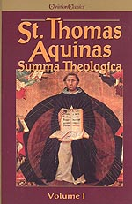
Summa Theologiae
Written from 1265-1274, this book was know to be Thomas’s great work. Originally written for the "instruction of beginners," time has shown that all believers can come to learn from this enriching book. Organized systemically for the clearest way of "setting forth" the "sacred doctrine," Aquinas addresses many of Christianity's most questions in this work.

