Slide 1
The Middle ages
Angeline Kintanar

Slide 2
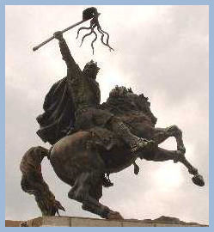
William the conqueror
He was an illegitimate child and was promised the English throne by the English king Edward the Confessor. Harold the earl of Wessex was given the throne instead and William the Conqueror sailed the English Channel with his enormous army to take back what he thought was rightfully his.

Slide 3
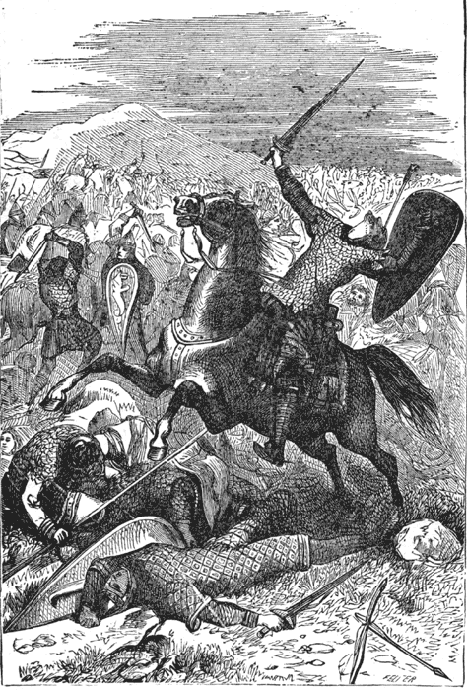
William the conqueror
He was an efficient and ruthless soldier. He defeated Harold in the Battle of Hastings. Once he was given the English throne, his great administrative feat was taxing people for their property.

Slide 4
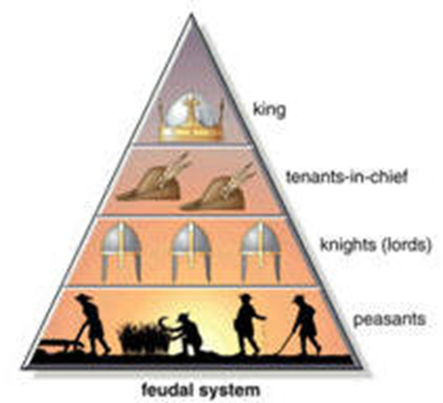
William the conqueror
He used a new social system called feudalism. It was also a caste system, property system, & military system. It was based on a religious concept of rank with God as the supreme overlord.

Slide 5
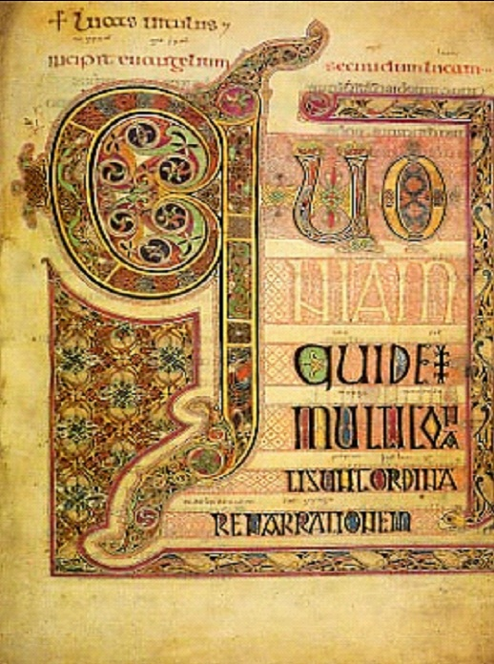
William the conqueror
The feudal system had a sense of form and manners. It influenced life, art, and literature of the Middle Ages.

Slide 6
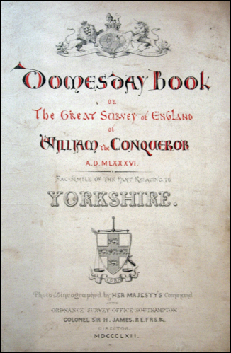
William the conqueror
He created the Domes day book was a book of taxation.

Slide 7
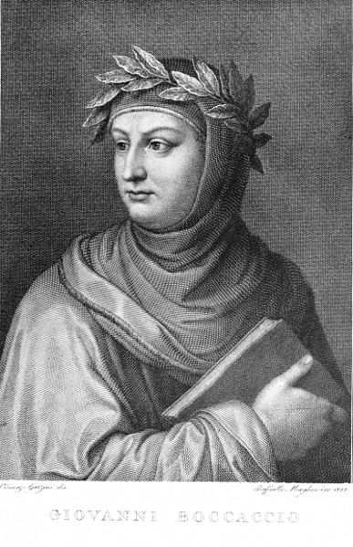
Giovanni Boccaccio
Born in Tuscany, the illegitimate son of a merchant of Certaldo.
At Naples he began to write stories in verse and prose, mingled in courtly society, and fell in love with the noble lady whom he made famous under the name of Fiammetta.

Slide 8
Up to 1350 Boccaccio lived at Florence and at Naples, producing prose tales, pastorals, and poems.
The Teseide is a version in ottava rima of the medieval romance of Palamon and Arcite, which was partly translated by Chaucer in the Knight's Tale, and is the subject of Fletcher's Two Noble Kinsmen

Slide 9
In 1358 he completed his great work, the Decameron, begun some ten years before.
Boccaccio's originality lay in his narrative skill and in the rich poetical sentiments which adorns his borrowed materials. The two great tendencies which run through European literature, the classical and the romantic, work together in the Decameron.

Slide 10
The influence of the Decameron on European literature has been lasting, not merely in Italy, but in France and England.
Chaucer and Shakespeare both borrowed from it. The Decameron has also been the subject of poems by Keats, Tennyson, Longfellow, Swinburne and George Eliot.
Boccaccio died at Certaldo, December 21, 1375.

