Slide 1
The Gunpowder Empires
By:
Jose Judo
&
Karen Kung-Fu

Slide 2
Who?
Three Islamic Empires.
The Ottoman, Safavid, and Mughal (Mongol).

Slide 3
What?
The ‘Gunpowder Empires’ term is used to focus attention and describe each empire’s impressive military exploits.
Each made newly developed firearms, small cannons, and other small arms.
And to equip their armies, each state developed a highly centralized administration that could mobilize the financial, manpower and natural resources necessary to purchase gunpowder arms and then supervise the deployment of those arms and the training of soldiers to use the weapons.

Slide 4
When?
1300-1650
The Empires expanded and began the process of consolidating and extending their realms with military might enhanced by the use of gunpowder weaponry.

Slide 5
The Ottoman Empire
The Ottomans were a Turkish dynasty that grew after the fall of the Mongols.
Ghazi Warriors .
Founder, Othman I, rose to prominence in the 14th century, as a ghazi or fighting lord.
Repeatedly raided what was left of the Byzantine Empire and later conquering Constantinople.
Led by Mohammed II, the Ottomans knocked down Constantinople's walls with the biggest cannons ever seen.
Considered the “Terror of Europe.”
Easily defeated Muslim rivals with superior technology.
Ottoman Empire spread into other parts of Europe. They used the new technology of gunpowder and artillery to devastating effect.
Ottomans became a world power. They absorbed new territories in Europe, Africa and Asia, and dominated the Muslim world.
Empire extended over Egypt, Anatolia, Syria-Palestine, most of North Africa, western Arabia, Mesopotamia, Iraq, Kurdistan, Georgia, and Hungary. The state was held together by a strong hereditary sovereign, and a strong military organization.
By 1774, the Ottoman Empire became a weak and crumbling empire, which staggered along until its eventual fall in 1918, in the wake of World War I.

Slide 6
SAFAVID EMPIRE
In many ways the cultural heart of the Islamic world.
Set up by Shah Ismāīl I in the early sixteenth century.
1501 - 1722.
Officially a Shiite empire.
Empire was short lived.
Often fought with the Ottomans.
Fell to Afghan invaders

Slide 7
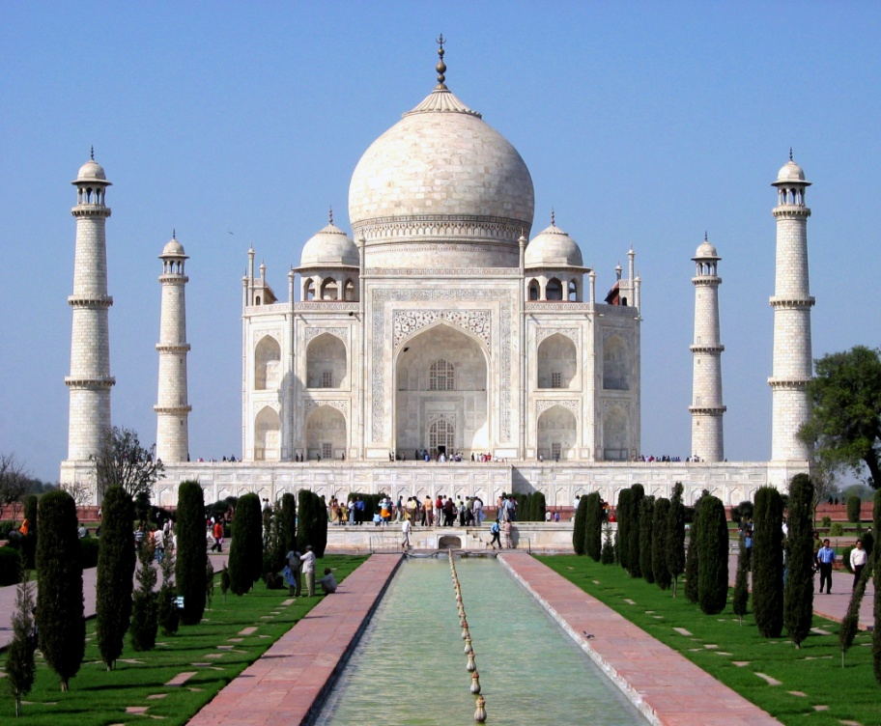
Mughal Empire
1523-1739
The Mughal firmly established their empire in northern India during the 16th century under the direction of Akbar the Great.
Public works (like the Taj Mahal ) drained the country’s budget.
Provided India with its 1st strong centralized leadership since the Guptas 1,000 years before.
Successors of the Mughal empire were descendents of Genghis Khan.
Founded by the Mongol leader Babur in 1526.
Armies were massive, with cavalry, artillery, and no navy.
Military technology was unable to match European power.
Firearms bought from European powers.
Akbar solidified power and made social changes.
Created a new religion with Hinduism and Islam but was
unsuccessful.
Allowed the Hindus to build temples again.
Promoted Hindus in the government.
Outlawed Sati, discouraged child marriage.

Slide 8
The language spoken by the Mughals also slowly adapted itself to a form of Hindustani known as ________.
A: Hindi

Slide 9
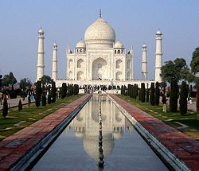
What does the following picture show?
A: Taj Mahal

Slide 10
Which empire used gunpowder to the greatest extent to cause devastating effect on its enemies?
A: The Ottoman Empire

Slide 11
Which empire emerged from the Mongol Empire?
A: Ottoman Empire

Slide 12
Which empire was the first Shiite empire of its kind?
A: Safavid Empire

Slide 13
The successors of this empire were the descendents of Genghis Khan.
A: Mughal Empire

Slide 14
Which emperor attempted to integrate the Hindu and Muslim religions?
A: Akbar

Slide 15
Which empire was the cultural heart of the Islamic world?
A: Safavid Empire

Slide 16
http://whhap.tripod.com/id4.html
http://novaonline.nvcc.edu/eli/evans/his112/Notes/Gunpowder.html
http://www.newworldencyclopedia.org/entry/Mughal_Empire
http://www.slideshare.net/dmcdowell/gunpowder-empires

