Slide 1
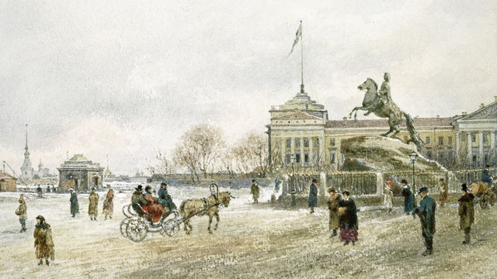
The Building Of St. Petersburg
Angela Guy

Slide 2
Who Founded It?
Saint Petersburg was founded by Tsar Peter the Great on 27 of May 1703.
In 1703 he began building a new city on Swedish lands occupied by Russian troops.

Slide 3
Who built St. Petersburg?
The city was built by conscripted peasants from all over Russia; a number of Swedish prisoners of war were also involved in some years under the supervision of Alexander Menshikov. Tens of thousands of serfs died building the city.
Every summer , the army forced thousands of luckless serfs to leave home and work in St. Petersburg.
Estimated 25,000 to 100,00 died from harsh working conditions.

Slide 4
How was St. Petersburg built?
St. Petersburg originated as a swampy land that was unhealthy and low in population.
The first structure to be built in the new city was the Peter and Paul fortress. Designed to protect the area from the attacks of the Swedish army and navy, the fort did not take part in actual fighting.
It was built in a “western form” because Peter the Great was really interested in the Western style and tried to reform the whole colony.
With the Serfs and the help of Peter they turned a marshy swamp into a beautiful westernized city.

Slide 5
Why did peter the great want to establish St. Petersburg?
To promote education growth, Peter wanted a seaport that would make it not as difficult to travel to the west so he attacked Sweden to gain a piece of the Baltic Coast.
He wanted to gain the “window on Europe”

Slide 6
What were the working conditions of the Serfs when creating St. Petersburg?
The Serfs were treated harshly and were forced to leave their families and work towards building St. Petersburg for Peter the Great.

Slide 7
What happened after St. Petersburg was finished?
After St. Petersburg was finished being created Peter ordered the Russian nobles to leave Moscow and settle in his new capital
Once this was happening the city became very busy.

Slide 8
Did Peter the Great succeed in westernizing St. Petersburg?
Peter did succeed in westernizing St. Petersburg. By the time he died Russia was a very powerful country.

Slide 9
St. Petersburg
After Peter the Great died St. Petersburg did have some hardships.
But after awhile it became a very well touristic area and a healthy economy.

Slide 10
St. Petersburg Today
Although, still far behind Moscow in economic terms, St. Petersburg had become a modern, rapidly growing commercial city. On the social side, St. Petersburg's younger generations are coping admirably with the economic changes, but unemployment remains high and families and pensioners struggle desperately to make ends meet.
St. Petersburg is one of the most beautiful cities in Europe today and they receive many tourists.

