Slide 1
Scientific revolution
Colbie northern B1

Slide 2
The start
The start of the Scientific revolution began in late 16th century and was a new way of thinking.
It laid the foundation that would lead into modern-day
physics, astronomy, biology, medicine and chemistry all came from the scientific revolution.

Slide 3
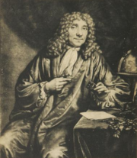
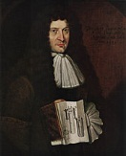
Important figures
Antonie van Leeuwenhoek, the first person to use a microscope to view bacteria
Denis Papin, best known for his pioneering invention of the steam digester, the forerunner of the steam engine

Slide 4
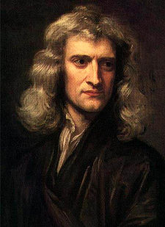
More figures
Sir Isaac Newton: Isaac Newton put the works of Copernicus, Kepler, and Galileo together explain planetary motion after the apple hit him on the head he came up with the theory of gravity

Slide 5
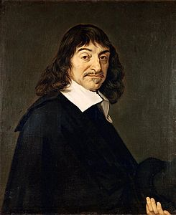
Another figure
René Descartes believed in Deductive Reasoning - go from general to specific. Famous Quote: "I think therefore I am." Invented analytical mathematics. Wrote Discourse on Method, reduced nature to mind and matter.

Slide 6
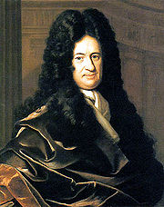
figure
Gottfried Leibniz (1646–1716) refined the binary system, foundation of virtually all modern computer architectures

Slide 7
How did it start
Ancient and medieval background
They improved Roman and Greek ideas
Most ideas about the earth being at the center of the cosmos at the time were Aristotle's own
The terrestrial region, according to Aristotle, consisted of concentric spheres of the four element-earth, water, air, and fire. Later gravity

Slide 8
religion
The revolution led to people thinking in their own way
Also lead to people eventually creating a new religion called Deism
They had no use for organized religion
And believed there is a all powerful creator but this being did not intervene with human life's

Slide 9
Effects on scientist
It brought about another option for the curious. Those who studied Science were not content with the World the way it was. This disrupted the Religious Establishment in Several parts of the World, no matter what the Religion was.
this is a major effect the caused Deism

