Slide 1
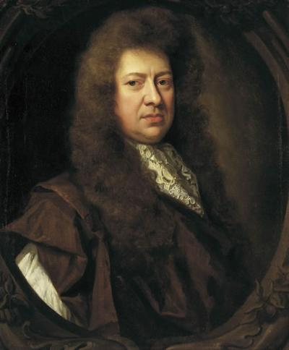
Samuel Pepys

Slide 2
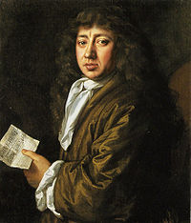
Samuel Pepys was born in Salisbury Court off Fleet Street in London, on 23 February 1633.
His father, John, was a tailor who came from a family of good yeomen stock long-settled in Cambridge shire.

Slide 3
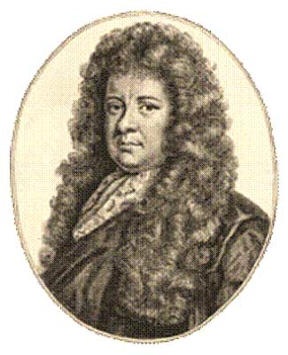
Shortly afterwards Pepys acquired a clerkship in the Exchequer.
This job gave him a little money, and he married Elizabeth St Michel in 1655.

Slide 4
It was in this house that Pepys started to write his diary, at the age of 27.
He was 36 when fear of losing his eyesight forced him to end it.
In June 1660 he was appointed Clerk of the Acts to the Navy Board, a key post in what was probably the most important of all government departments, the royal dockyards.

Slide 5
Pepys's diary is not so much a record of events as a re-creation of them.
Not all the passages are as picturesque as the famous set pieces in which he describes Charles II's coronation or the Great Fire of London, but there is no entry which does not, in some degree, display the same power of summoning back to life the events it relates.

Slide 6
The diary's contents are shaped also by another factor its geographical setting.
It is a London diary, with only occasional glimpses of the countryside.
Yet as a panorama of the seventeenth-century capital it is incomparable, more comprehensive than Boswell's account of the London a century later because Pepys moved in a wider world.

Slide 7
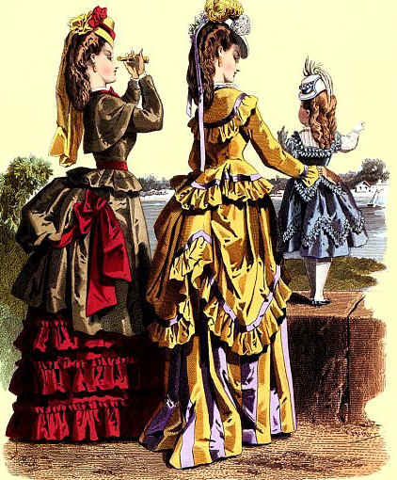
The Victorian Period

Slide 8
The Victorian era is generally agreed to stretch through the reign of Queen Victoria (1837-1901).
It was a tremendously exciting period when many artistic styles, literary schools, as well as, social, political and religious movements flourished.
It was a time of prosperity, broad imperial expansion, and great political reform. It was also a time, which today we associate with "prudishness" and "repression".
Without a doubt, it was an extraordinarily complex age, that has sometimes been called the Second English Renaissance.
It is, however, also the beginning of Modern Times.

Slide 9
Improvements in diet
His passage demonstrates both the frequent occurrence of typhus, cholera, typhoid and other such diseases during the Victorian Era, but also increased public interest in dealing with and preventing these scourges.
The industrialization and urbanization of England had a tremendous and often detrimental effect on its inhabitants.
Poor living conditions, sanitation and hygiene existed even for the wealthy, but especially among the impoverished who lived in tenements and slums veritable breeding grounds for diseases

Slide 10
The reform bills
he three Reform Acts, of 1832, 1867, and 1884, all extended voting rights to previously disfranchised citizens.
The first act, which was the most controversial, reapportioned representation in Parliament in a way fairer to the cities of the industrial north, which had experienced tremendous growth, and did away with "rotten" and "pocket" boroughs like Old Sarum, which with only seven voters (all controlled by the local squire) was still sending two members to Parliament.
This act not only re-apportioned representation in Parliament, thus making that body more accurately represent the citizens of the country, but also gave the power of voting to those lower in the social and economic scale, for the act extended the right to vote to any man owning a household.

Slide 11
The popular Mr. Dickens
Mr. Dickens was born at Portsmouth, England, on 7th February, 1812.
His father was for many years a Paymaster in the British Navy; on his retirement he became a reporter on the London press, and it was through him that Mr. Dickens first connected himself with journalism.
His father's idea was that he should be an attorney; but a few months' work in a London office satisfied any longings he may have had for distinction in that profession.
Abandoning the law, he became a reporter on the Sun, and afterward on the Morning Chronicle; studied short-hand assiduously, and for some years had had his seat in the Reporters' Gallery in the House of Commons.

