Slide 1
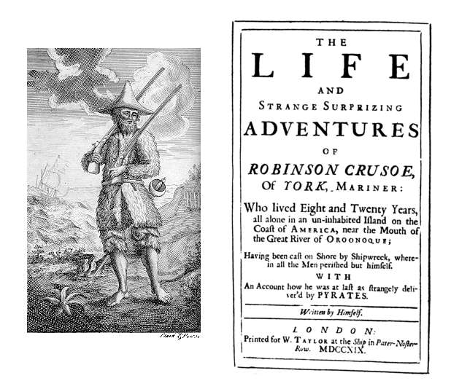
Restoration & DeFoe

Slide 2
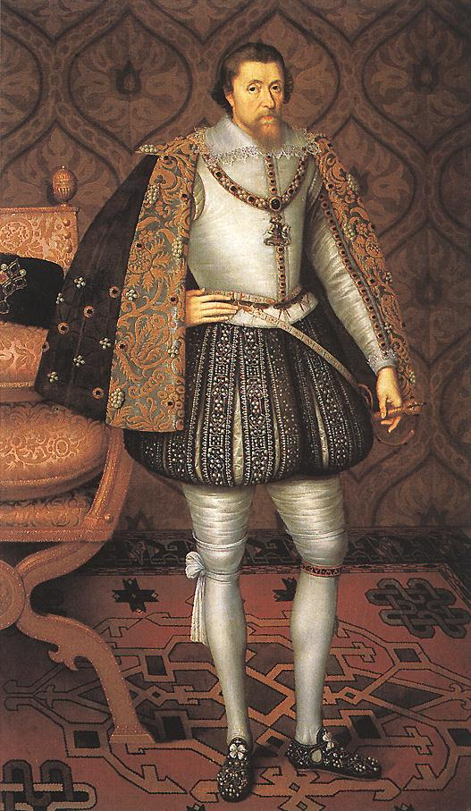
Restoration
The Bloodless Revolution
Journalism
Law
Satire

Slide 3
Revolution
Charles II died
James II became king
James’s daughter, Mary, was wanted by Protestants to rule England
William of Orange, Mary’s husband, forced James to flee
William & Mary assumed the throne without a drop of blood being shed

Slide 4
Journalism
Focus shifted to concerns with the middle-class
Thrift, work, domestic relations, and social respectability
Urged improvement in public manners and morals

Slide 5
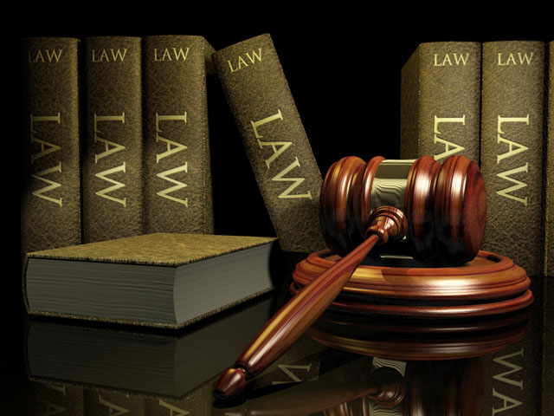
Law
All men were equal, but some were more equal than others
Especially England’s wealthy

Slide 6
Satire
Scientifically minded, God is indifferent
Satire made things easy to take
Alexander Pope & Jonathan Swift

Slide 7
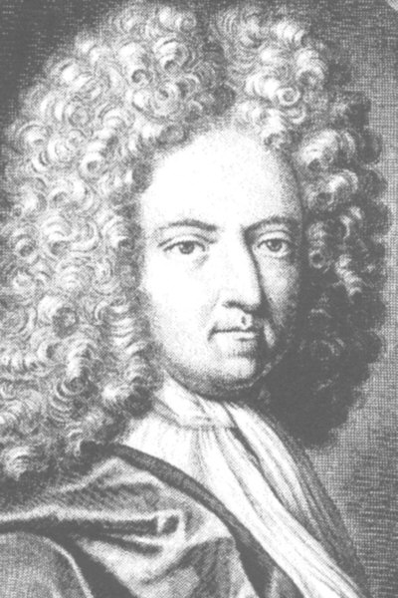
Daniel DeFoe
1661-1731
English writer, journalist, and pamphleteer
Founder of the English novel
Wrote more than 500 books
Gained fame for Robinson Crusoe

Slide 8
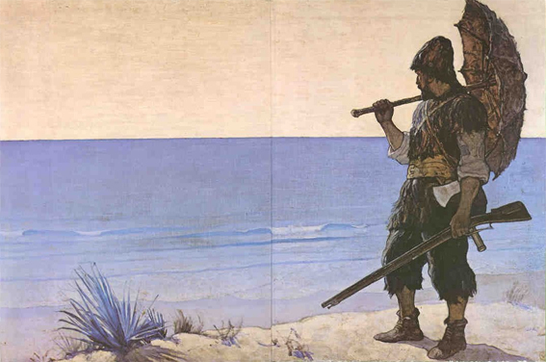
Robinson Crusoe
Published in 1719
Fictional autobiography of Robinson
Perhaps influenced by Alexander Selkirk

Slide 9
Actual title
The Life and Strange Surprizing Adventures of Robinson Crusoe, of York, Mariner: Who lived Eight and Twenty Years, all alone in an un‐inhabited Island on the Coast of America, near the Mouth of the Great River of Oroonoque; Having been cast on Shore by Shipwreck, wherein all the Men perished but himself. With An Account how he was at last as strangely deliver’d by Pyrates.

Slide 10
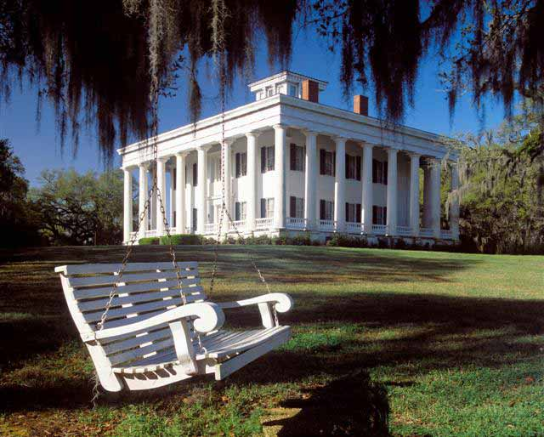
Plot
Crusoe goes on a voyage
Journey ends in disaster, Crusoe becomes a slave
He escapes with the help of a friend
Becomes the owner of a plantation

Slide 11
Summary
Discovers cannibals on an island
Converts them to Christianity
Returns home after his family has been thinking he’s dead, leaving nothing for him
Reclaims his estate’s profits and sails back to England, embarks on one last adventure involving famished wolves

