Slide 1
Renaissance
Karlee Lindsey

Slide 2
Humanism: A new intellectual movement

Slide 3
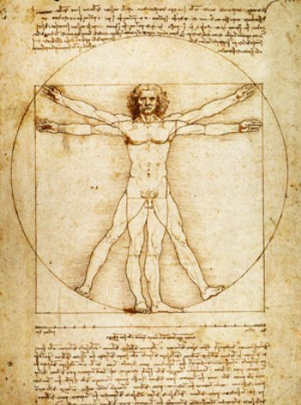

Slide 4
Humanism
During the renaissance educated people began to embrace humanism.

Slide 5
Major Subjects
Philosophy, history, languages, and arts.

Slide 6
Humanism
Humanists looked not only to the bible, but also to the Latin and Greek classics for wisdom and knowledge.
The printing press helped spread this new emphasis on the humanities. Therefore, more books were available.

Slide 7
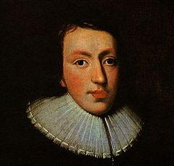
John Milton
He was an English poet, polemicist, and civil servant for the Commonwealth of England. He is best known for his epic poem Paradise Lost

Slide 8
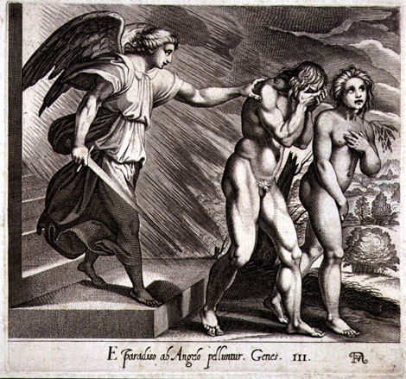
Paradise Lost
He states that his subject will be Adam and Eve’s disobedience and fall from grace. He invokes a heavenly muse and asks for help in relating his ambitious story and God’s plan for humankind. The action begins with Satan and his fellow rebel angels who are found chained to a lake of fire in Hell.

Slide 9
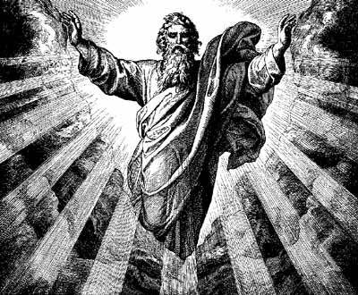
They quickly free themselves and fly to land, where they discover minerals and construct Pandemonium, which will be their meeting place. Inside Pandemonium, the rebel angels, who are now devils, debate whether they should begin another war with God..

Slide 10
Beezelbub suggests that they attempt to corrupt God’s beloved new creation, humankind. Satan agrees, and volunteers to go himself. As he prepares to leave Hell, he is met at the gates by his children, Sin and Death, who follow him and build a bridge between Hell and Earth

Slide 11
Quote
“The mind is its own place, and in itself can make a heav'n of hell, a hell of heav'n.”

