Slide 1
The Renaissance

Slide 2
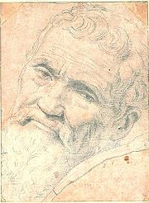
Michelangelo
Italian Renaissance painter, sculptor, architect, poet, and engineer
Best known works
David and The Pieta

Slide 3
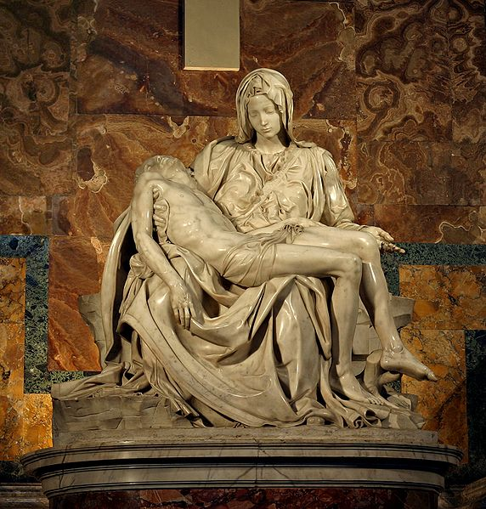
Pieta By Michelangelo

Slide 4
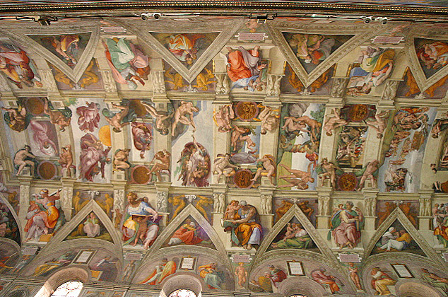
Sistine Chapel By Michelangelo

Slide 5
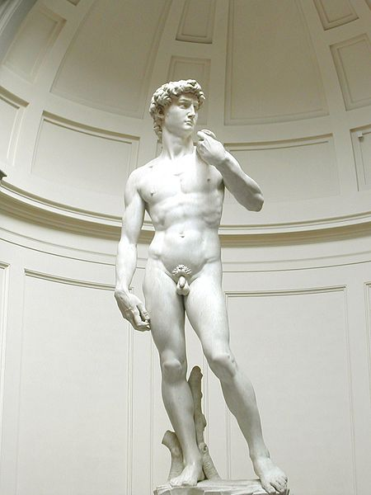
David By Michelangelo

Slide 6
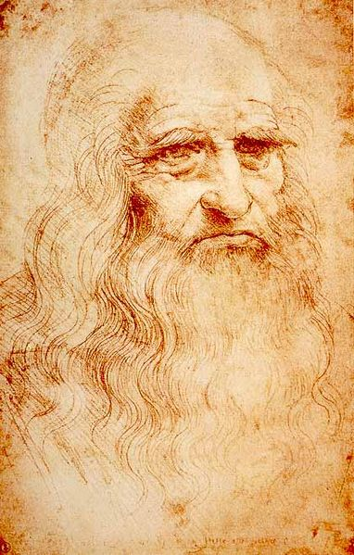
Leonardo da Vinci
Italian scientist, mathematician, engineer, inventor, anatomist, painter, sculptor, architect, botanist, musician, and writer
Most famous works
Last Supper and Mona Lisa
http://www.youtube.com/watch?v=JQM0bfBQvDA

Slide 7
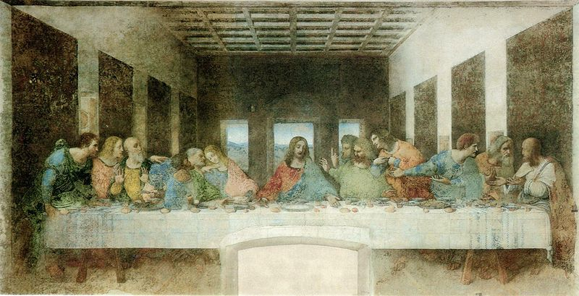
Last Supper By Leonardo da Vinci

Slide 8
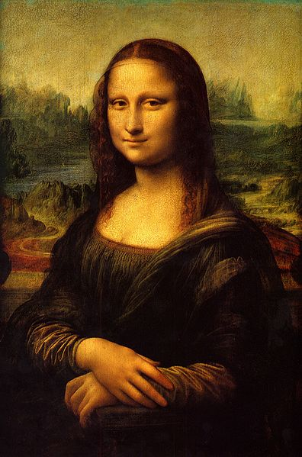
Mona Lisa By Leonardo da Vinci

Slide 9
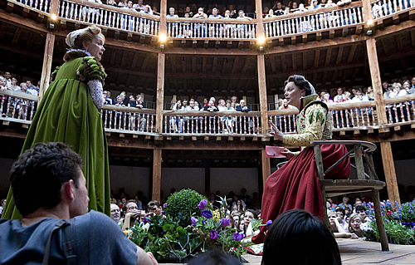
William Shakespeare
Shakespeare wrote many sonnets, plays, and essays which we still enjoy today.

Slide 10
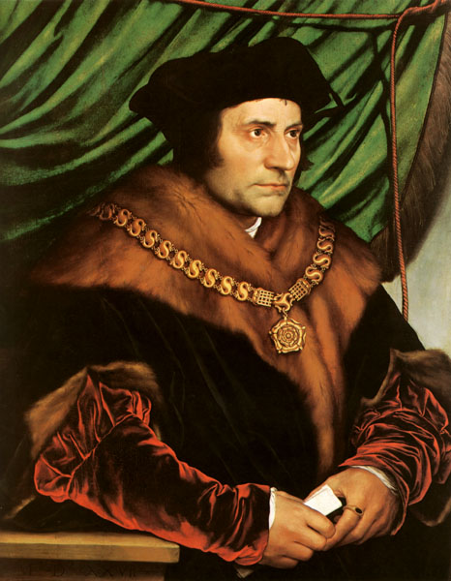
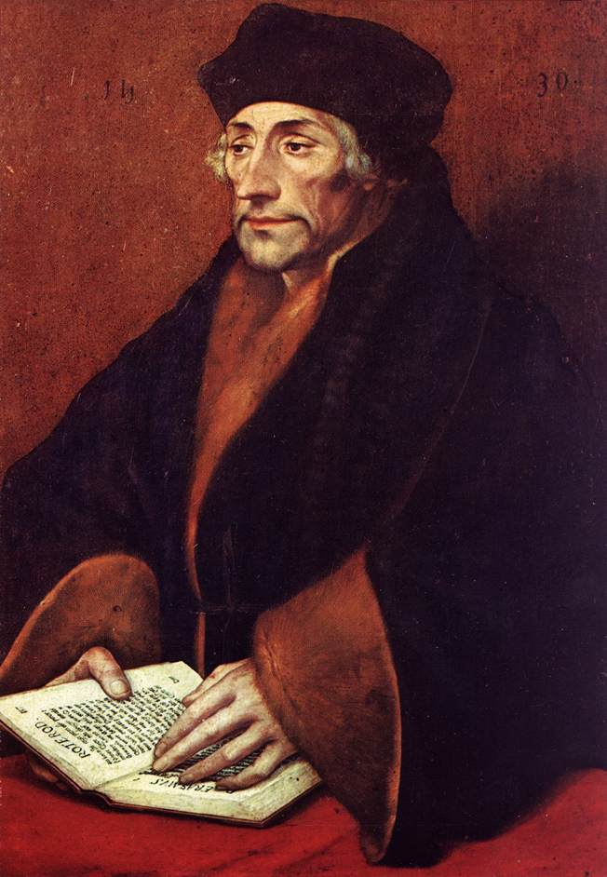
The Northern Renaissance
The Northern Renaissance was more Christian in nature than the Italian Renaissance. Christian humanists encouraged social reform and tried to combine the best elements of classical and Christian cultures.
Sir Thomas More wrote a book called Utopia, in which all people were equal.
Erasmus wrote In Praise of Folly which pointed out the corruption of the Roman Catholic Church.
Thomas More
Erasmus

