Slide 1
Renaissance Nie Kao and Arielle Hankerson
Italian and Northern

Slide 2
Who, Where, When
Wealthy city-states of Italy
Germany
Netherlands
France
England
Roughly 1350-1700
Humanists
Artists
Writers
Scholars

Slide 3
Important People
Niccolo Machiavelli- humanist, wrote The Prince, the book described government not by lofty ideals but how it actually worked.
Leonardo DaVinci- architect, engineer, painter, sculptor, scientist, The Last Supper, Mona Lisa
Michelangelo- painter, frescos in the Sistine Chapel of the Vatican, sculptor of David
Petrarch- one of the first humanists, Sonnets to Laura, one of the greatest love poems of all time
Johannes Gutenberg- invented the printing press which impacted economic, social, and technological aspects of society, threatened scribes professions, and spread humanists’ ideas to a large audience.

Slide 4
Important People (cont.)
Desiderius Erasmus- most influential humanist in northern Europe, believed the ideas of Christianity and classical civilization could be harmonized, used critical method of Italian humanists to study the Bible, criticized the Church's lack of spirituality, argued for a return of the original, simple message to Jesus, wrote The Praise of Folly, which ridiculed ignorance, superstition , and vice among Christians. Criticized fasting, pilgrimages to religious shrines, and even the interpretation of the Bible
Thomas More- English humanist who had a similar view to Erasmus, 1516 published Utopia, whi9ch condemned governments as corrupt and argued that private ownership of properties causes unnecessary conflicts between people. He contrasted life in Europe with his description of an imaginary, ideal society. Was executed, because he refused to agree that the king was the supreme head of the church in England. Catholic church made him a saint for his faith and service to the church.
Christopher Marlowe- wrote plays that tended to focus in human rather than godly actions.
William Shakespeare- built on the traditions established by Marlowe and other playwright, his strength was his ability to transform well-known stories into dramatic masterpieces(Hamlet, Romeo and Juliet, Macbeth)

Slide 5
What
The renaissance, or “rebirth”, was a philosophical and artistic movement and the era in which that movement flourishes
Marked by a renewed interest in ancient Greek and Roman literature and life
Medieval scholars had studied ancient history and tried to bring everything they learned into harmony with Christian teachingc.

Slide 6
Why, How
Some sources suggest it was natural that the Renaissance took place. Especially beginning in Italy where ruins of the Roman Empire reminded the Italians of Roman glory. The crusades and trade had brought them into contact with the Byzantine civilization, whose scholars had preserved Greek and Roman learning. Trade with southwestern Asia and Africa helped Italians learn of Arab and African achievements in science and medicine. This encouraged curiosity and the search for new knowledge among some Italian thinkers, later spreading to northern Europe by way of mountain passes and rivers.

Slide 7
Comparative
Used perspective which made distant objects smaller than those in the foreground of the painting to create an illusion of depth on a flat canvas.
Renaissance began in Italy
Studied ancient history and tried to bring everything they learned into harmony with the church.
Unlike Italian humanists, Northern humanists were interested in the early Christian period, as well as early Greek and Roman culture.
More outspoken in the agreement within the arts and church
Renaissance later spread to northern Europe
Italian
Northern

Slide 8
Comparative
Niccolo Machiavelli
Leonardo DaVinci
Michelangelo
Petrarch
Wealthy supported the arts
Made a secular turn
Used science in their art
Antiquity
Flemish school- a group of painters in Flanders credited with perfecting certain techniques in painting in oil on canvas.
Christopher Marlowe
William Shakespeare
Jan and Hubert van Eyck
Johannes Gutenberg
Italian
Northern

Slide 9
Comparative
Explore mans supposed capacity for rational choices
Had many frescos
Studied ancient world to explore great accomplishments
The Renaissance occurring in Europe outside of Italy
Innovative art
Held onto Gothic architecture
Fewer centers for commerce
Stain glass
Religious reform
classical
Italian
Northern

Slide 10
The Renaissance began in the wealthy city-states of____.
Italy

Slide 11
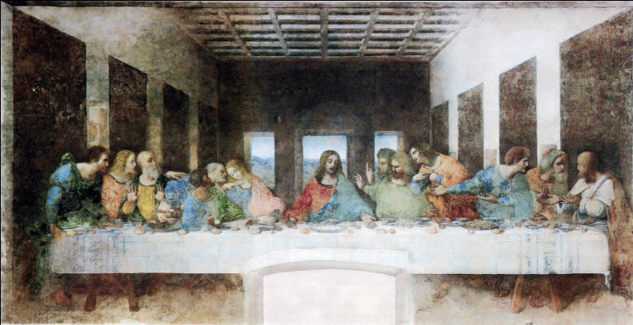
What Italian Renaissance artist painted the Mona Lisa as well as The Last Supper?
Leonardo DaVinci

Slide 12
Who was the Italian humanists that wrote Sonnets to Laura, one of the greatest love poems of all time?
Francesco Petrarch

Slide 13
The word “Renaissance” literally means_____.
Rebirth

Slide 14
How did the Renaissance begin?
Medieval scholars began to study ancient history and tried to bring everything they learned into harmony with Christian teachings.

Slide 15
What characterized the though of this era?
The Renaissance was marked by a renewed interest in ancient Greek and Roman literature and life.

Slide 16
How did Renaissance art differ from art of the middles ages?
Medieval paintings stressed the world beyond everyday life, used formal figures to express religious concerns, and the backgrounds of most medieval paintings depicted the Holy Land. Renaissance artists created realistic scenes and images, depicted life-like human figures in their paintings, and used the well known Italian landscape as their backgrounds. Italian renaissance artists also used the technique known as perspective.

Slide 17
Who wrote The Prince?
Niccolo Machiavelli

Slide 18
How ere the ideas of the Italian Renaissance spread to other parts of Europe?
Ideas spread through mountain passes in the Alps, as well as being passed by way of the Danube, Rhine, and Rhone rivers from Northern European students who had studied in Italy.

Slide 19
In what way did northern Renaissance writers differ from Italian humanists?
Unlike Italian humanists, the Northern humanists were interested in the early Christian period as well as early Greek and Roman culture.

Slide 20
Why did the printing press spread so quickly throughout Europe?
It offered a faster way to spread information, as well as an easier way to transport in books instead of scrolls.

Slide 21
How did religion influence Renaissance art and thought?
Most Renaissance artists, scholars, and humanists tried to bring together Christian teachings with their art, without going against the church.

Slide 22
What ethical issues did humanists struggle with during the Italian Renaissance?
They were trying to spread realistic ideas without going against the church.

Slide 23
What were the events that Led to the Renaissance in Italy?
Some sources suggest it was natural that the Renaissance took place. Especially beginning in Italy where ruins of the Roman Empire reminded the Italians of Roman glory. The crusades and trade had brought them into contact with the Byzantine civilization, whose scholars had preserved Greek and Roman learning. Trade with southwestern Asia and Africa helped Italians learn of Arab and African achievements in science and medicine. This encouraged curiosity and the search for new knowledge among some Italian thinkers.

Slide 24
Works Cited
Gilmore, Myron P. “Renaissance.” Encyclopedia Americana. 2010. Grolier Online. 1 Oct. 2010 <http://ea.grolier.com/article?id=0330830-00>.
Hooker, Richard. “ Backgrounds to the Italian Renaissance.” 1996. 1 Oct. 2010 <http://wsu.edu/~dee/REN/BACK.HTM>.
Modern World Holt World History the Human Journey. Austin: Holt, Rhinehart, and Winston, 2005.
Spodek, Howard. The World’s History Third Edition Combined Volume. Upper Saddle River, N.J.: Pearson Prentice Hall, 2006, 2001, 1996.
“What is the Italian Renaissance.” 2002. 1 Oct. 2010 <http://www.essortment.com/all/whatistheit_rgjm.htm>.

