Slide 1
Military Campaigns of the American and French Revolution
By: Chris Lantrip

Slide 2
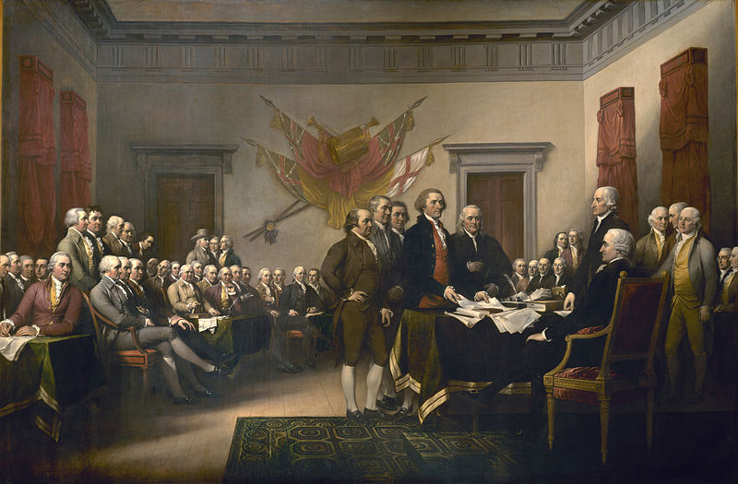
What the American Revolution Was
The American Revolution was the political upheaval in which thirteen colonies in North America joined together to break free from the British Empire, combining to become the United States of America.

Slide 3
When the American Revolution Started and Ended
The American Revolution started in 1775 and went on to 1783.
By 1774 the colonies had developed the Provincial Congress, by 1775 the colonies developed the Second Continental Congress, and by 1776 the North American colonies had severed their ties with the British Empire.
In which new found government had established its independence from the British Empire and this document to prove it was called the Declaration of Independence.

Slide 4
What the American Revolution Accomplished
The American Revolution succeeded in getting the rights for the people of America
America also got its Independence from the British Empire, which made a constitution that made fair laws for the people.

Slide 5
Important American Revolutionary War Campaigns
Some of the most important battles of the American Revolution were the battle of Saratoga, battle of Bennington, siege of Charlestown, and the battle of Yorktown.

Slide 6
The campaigns that started and ended the American Revolutionary War
The first campaign for the American Revolutionary War was the battle of Lexington and Concord Massachusetts (April 19, 1775).
The last campaign that ended the war was the Siege of Cuddalore(June 7–25, 1783) in Virginia.

Slide 7
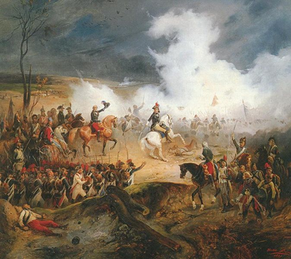
What the French Revolution was
The French Revolution was a period of radical social and political upheaval in France and Europe.
French society underwent an epic transformation as feudal, aristocratic and religious privileges evaporated under a sustained assault from radical left-wing political groups, masses on the streets, and peasants in the countryside

Slide 8
When the French Revolution started and ended
The French Revolution began in 1789 with the convocation of the Estates-General in May.
The French Revolutionary Wars started in 1792
The French Revolution ended in 1804 with the crowning of the Napoleon as emperor.

Slide 9
What was the result of the French Revolution
The French Revolution resulted in the reign of terror in which 16,000 – 40,000 people were killed between 1793 and 1794

Slide 10
Important French Revolution Campaigns
Most of the French Revolution campaigns were a part of the Napoleonic Wars.
War of the First Coalition
War of the Second Coalition

Slide 11
The campaigns that started and ended the French Revolution
The First Coalition took place between 1792 and 1797.
The Second Coalition took place between 1798–1801.
The French Revolution ended with the Treaty of Amiens.

Slide 12
10 Questions for the American And French Revolution Campaigns
When did the American Revolution start?
What was the first American Revolution campaign?
What was the last American Revolution campaign?
When did the American Revolution end?
When did the French Revolution start?
What was the first French Revolution campaign?
What was the last French Revolution campaign?
When did the French Revolution end?
What were some important campaigns for both the American and French Revolutions?
What were the results of the American and French Revolutions?
Notes:
See pg. 13 for answers.

Slide 13
Answers to Questions
1775
Battle of Lexington and Concord Massachusetts
Siege of Cuddalore
1783
1789
First Coalition
Second Coalition
1804
Battle of Saratoga, battle of Bennington, siege of Charlestown, and the battle of Yorktown.
The First Coalition, and the Second Coalition

