Slide 1
Middle Ages
By: Sarah Basham

Slide 2
William the Conqueror
Sent an army across the English Channel to seize the throne
Norman and Anglo-Saxon culture in England
Brought Feudalism to England
Taxed based on ownership

Slide 3
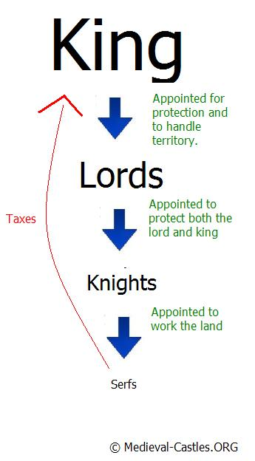
Feudalism
Social, caste, property, and military system
God is supreme overlord
King held divine rights

Slide 4
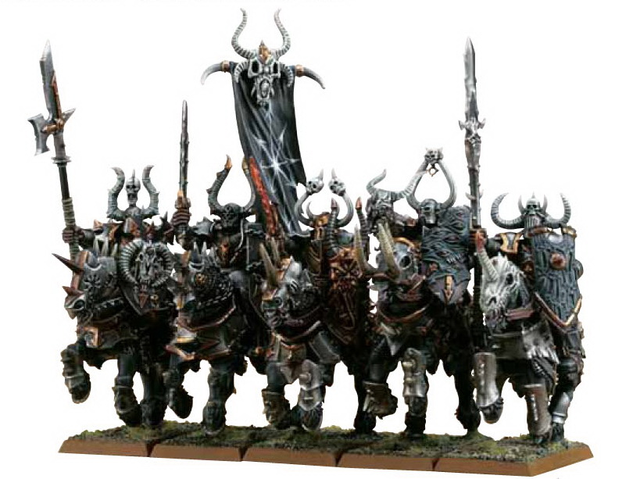
Knights
Little boys trained as special homes to be knights
Very strict rules

Slide 5
Women
No rights
Worked in fields
Objects of possession

Slide 6
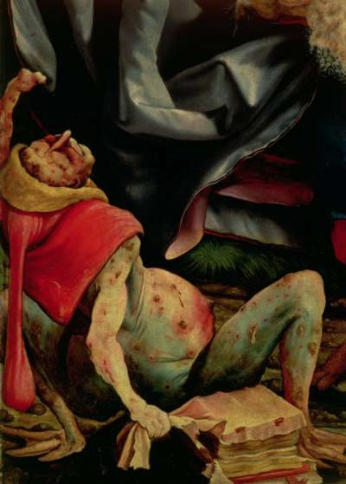
Black death
Bubonic plague
Wiped out 1/3 of the population
No cure
Spread by fleas on rats

Slide 7
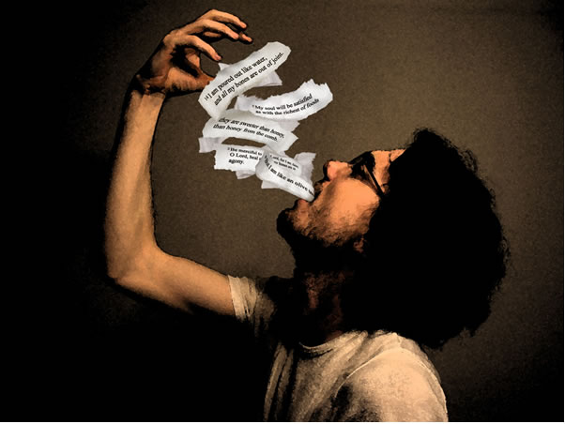
Geoffrey Chaucer
1343-1400
“Father of English poetry”
Wrote in the vernacular, which is the everyday language spoken in London

Slide 8
Early Life
Father was a wine merchant
Chaucer read many books
Had legal training
Had the finest training in good manners

Slide 9
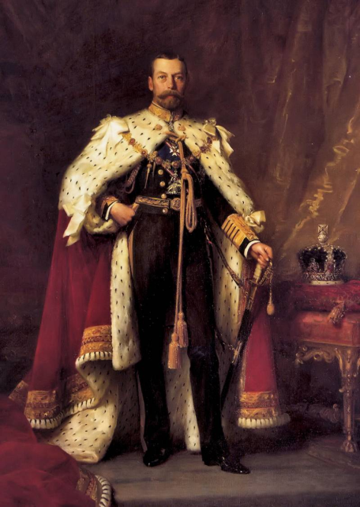
Achievements
King contributed ransom to free him from France during the Hundred Years’ War
Married and had two children
Sent to Europe as the king’s ambassador many times

Slide 10
Achievements cont.
Awarded several pensions for his services to the Crown
Granted the promise of a daily pitcher of wine
Appointed justice of the peace in the county of Kent
Member of Parliament

Slide 11
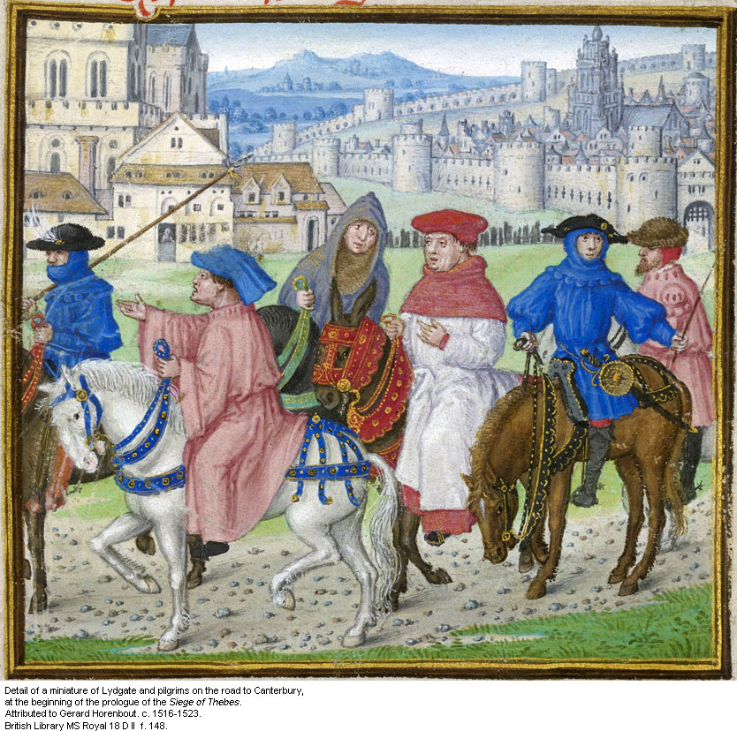
Writings by Geoffrey Chaucer
The Canterbury Tales
The Book of the Duchess
House of Fame
Legend of Good Women
Troilus and Criseyde
Anelida and Arcite
Treatise on the Astrolabe

