Slide 1
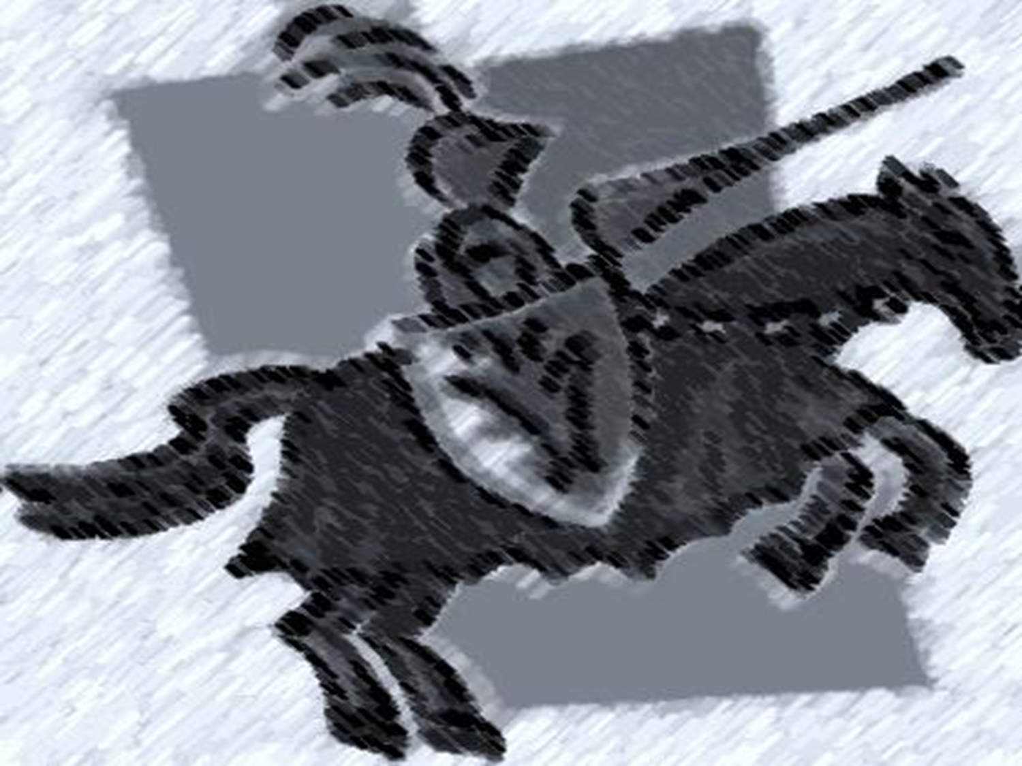
Middle Ages
BY: Courtney Cain

Slide 2
Knights
The knight in shining armor was the main symbol of the period.
After the 100 years war, the symbol shifted from the knight to a yeoman with a bow.
Knights were warriors who were trained from childhood and followed the code of chivalry, which is individual training and service to others.

Slide 3
POWER
The king was the leader of the general public, but there were other people in charge of other things.
The pope was in charge of the church and ultimately held the most power.
Lords were in charge of feudal territory and below them were the tenants of the area.

Slide 4
Power and the magna carta
King John was forced to sign the Magna Carta.
It was constructed by aristocrats for aristocrats and really did little for the “common” man.
It challenges the authority of the king and lets more power lie with the people.
It is the basis for the English Constitution

Slide 5
The Feudal System
The feudal system was a strict caste system for ordering society around relationships that derived from the holding of land in exchange for service or labor.
God was the supreme overlord of the feudal system and they were all working to please God.
The feudal system influence life, art and literature.

Slide 6
Feudalism Continued…
Feudalism was divided between lords, vassals and serfs.
The lords were nobility who held some amount of land.
The vassals were granted land by the lords and had to provide some sort of service to the lord in exchange for land and protection.
Serfs were no more than peasants and were basically just slaves.

Slide 7
Dante Alighieri
Born on May/June c.1265 and died on September 14, 1321.
Born in Florence, Italy.
Respected Italian poet of the middle ages.

Slide 8
At the age of 12, he was arranged to be married to a woman named Gemma di Manetto Donati who was the daughter of Manetto Donati.
The Donati family was a very powerful Italian family of the age, so, it was most likely a politcal move for the families involved.

Slide 9
When Dante was 9 years old he met a girl named Beatrice Portinari and fell in love with her.
He features Beatrice in a good deal of his poems and sonnets, but never his own wife.

Slide 10
Dante’s most famous work is The Divine Comedy.
It is divided into 3 parts; Inferno, Purgatorio, and Paradiso.
Each part is divided into 33 cantos.
The number 3 is very prominent because it was though to be the holy number because of the trinity (Father, Son and Holy Spirit).
The epic poem is about Dante’s journey through hell and purgatory to ultimately reached his beloved Beatrice in Paradise.

Slide 11
Dante is known as the supreme poet in Italy.
Dante, along with Petrarch and Boccaccio are known as "the three fountains" or "the three crowns".

Slide 12
Works Cited
http://en.wikipedia.org

Slide 13
THE END

