Slide 1
Logos & Letterhead
Global Connections Seminar

Slide 2
What is a logo?
A logo is a unique identifying symbol.
A logo also is called a brandmark, mark, identifier, logotype, or trademark.

Slide 3
Types of Logos
Logos can take the form of a wordmark.
Wordmark (also called logotype) is the name spelled out in unique typography or lettering

Slide 4
Types of Logos
Logos can take the form of a lettermark.
The logo is created using the initials of the brand name.

Slide 5
Types of Logos
Logos can take the form of a symbol mark -- an abstract or non-representational visual or a pictorial visual.
An abstract symbol mark is a representational visual with an emphasis on the intrinsic form, an extraction relating to a real object modified with an abstract emphasis

Slide 6
Types of Logos
A non-representational or non-objective symbol mark is a visual which is a non-pictorial visual that symbolizes the brand or social cause, one that does not relate to a person, place, activity, or an identifiable object.

Slide 7
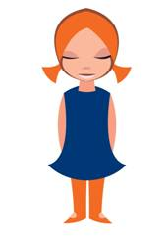
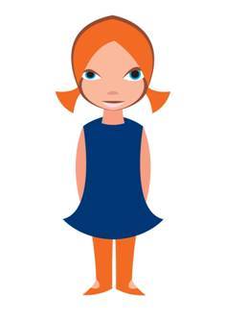
Types of Logos
A pictorial symbol mark is a representational image that symbolizes the brand or social cause; it relates to an identifiable person, place, activity, or object.

Slide 8
Types of Logos
Combination mark
A combination of words and symbols

Slide 9
Logos & Visual Identity
A logo plays a key role in the visual identity of a brand, social organization, or company.

Slide 10
Applications for a Logo
A logo should work for all necessary applications.
Packaging
Stationery (letterhead, business card, envelope)
Signage
Advertisements
Clothing
Posters
Shopping bags
Menus
Forms
Covers

Slide 11
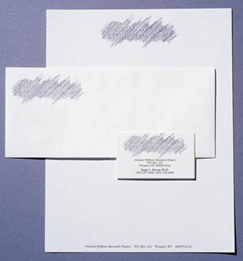
Letterhead
A staple of any visual identity is stationery/letterhead.
Most designers position information at the head, or top, of the page, which is why we call it letterhead.

Slide 12
Choosing Font & Color
Choosing a font and color for a logo/letterhead should be based on:
Both form and expression
Meaning

Slide 14
4633 B Coronet Ave
Virginia Beach, VA 23455
757.555.5555
katherine.snyder@ vbschools.com
4633 B Coronet Ave
Virginia Beach, VA 23455
757.555.5555
katherine.snyder@vbschools.com

Slide 16
Assignment
Using MS Publisher…
Create three logo designs using your name.
Create one letterhead design on an 8.5 X 11 sheet of paper using one of the three logos you designed.
Your logo should be multi-purposeful; you will be required to use it on your website

