Slide 1
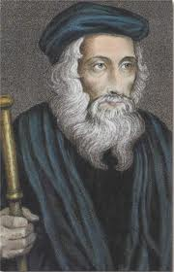
John Wycliffe
By
Reggie Andrews

Slide 2
John Wycliffe lived almost 200 years before the Reformation, but his beliefs and teachings closely match those of Luther, Calvin and other reformers.
As a man ahead of his time, historians have called Wycliffe the "Morning star of the Reformation."

Slide 3
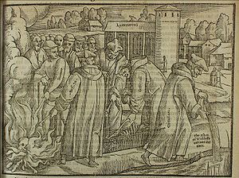
Born in the 1300s, Wycliffe criticized abuses and false teachings in the Church.
In 1382 he translated an English Bible—the first complete European translation done in nearly 1,000 years.
The Lollards, itinerant preachers he sent throughout England, inspired a spiritual revolution.

Slide 4
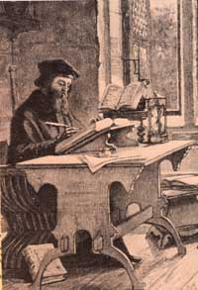
But the Lollardy movement was short-lived.
The Church expelled Wycliffe from his teaching position at Oxford, and 44 years after he died, the Pope ordered his bones exhumed and burned.

Slide 5
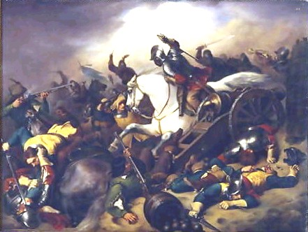
Intense persecution stamped out his followers and teachings.
It would be hundreds of years before men like Martin Luther resurrected the reforms of which Wycliffe dreamed.

Slide 6
John Wycliffe left quite an impression on the church: 43 years after his death, officials dug up his body, burned his remains, and threw the ashes into the river Swift.
Still, they couldn't get rid of him. Wycliffe's teachings, though suppressed, continued to spread.
As a later chronicler observed, "Thus the brook hath conveyed his ashes into Avon; Avon into Severn; Severn into the narrow seas; and they into the main ocean.
And thus the ashes of Wycliffe are the emblem of his doctrine which now is dispersed the world over."

Slide 7
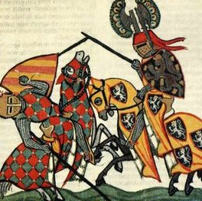
The middle ages 1066 -1485
The Middle Ages encompass one of the most turbulent periods in English History. Starting with the Battle of Hastings and the Norman Conquest - when William the Conqueror effectively took all of the lands from the Saxon English and gave them to French nobles. The English Middle Ages then saw the building of the great English castles, including the Tower of London, which helped the Normans to retain their hold on England.

Slide 8
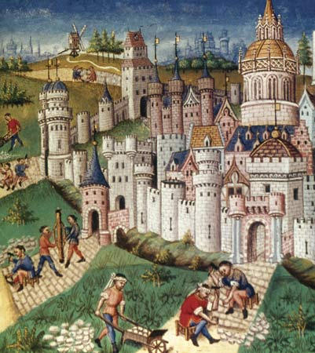
The start of the Crusades and the knights of the Middle Ages, including the founding of the Knights Templar. The Domes day Book and the Magna Carta. The Kings and Queens of the Middle Ages including Richard the Lion heart and great Plantagenet Kings from Henry II (1154-1189) to Edward III (1327-1377). The Hundred Years War between England and France. The Medieval Kings and Queens of the Royal Houses of Lancaster and York and the Wars of the Roses. The Middle Ages Feudal System and the terrible Black Death which really did plague the period of the Middle Ages.

Slide 9
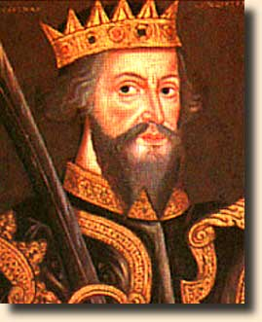
The Normans - William the Conqueror
William, the illegitimate son of Robert, Duke of Normandy, was born at Fallacies Castle, Normandy, in 1027 or 1028. He was known as William the Bastard.
When his father died in 1035, William was named as his successor.
By the time that he was twenty-seven, he had earned himself a good reputation as a strong leader. He defended Normandy well from repeated attacks by the French and was feared as a military leader.

Slide 10
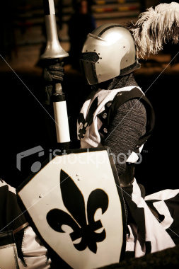
Knights in shining armor
Late in the Middle Ages plate armor began to appear (ca. late 13th/early 14th century), first as reinforcements to vital areas such as the chest and shoulders, and finally as a complete suit (ca. early 15th century). The medieval "knight in shining armor" that most people think of is the fully plate-armored knight.
Chainmail armor was now relegated to protecting smaller vital areas that could not be covered with plate armor, such as the groin and under the arms. The shield became smaller, or disappeared altogether as it became unnecessary and redundant.

Slide 11
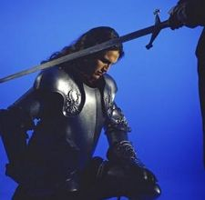
In medieval history, the knight was an armed and mounted warrior belonging to the nobility. The incessant private warfare that characterized medieval times brought about a permanent military class, and by the 10th cent. the institution of knighthood was well established. The knight was essentially a military officer, although with the growth of feudalism, form of political and social organization typical of Western Europe from the dissolution of Charlemagne's empire to the rise of the absolute monarchies.
The term tended to denote the holder of not only a position in the ranks of nobility but also in the ranks of landholders. The knight generally held his lands by military tenure; thus knight service was a military service, usually 40 days a year, normally expected by an overlord in exchange for each fief held by a knight. All military service was measured in terms of knight service, and a vassal might owe any number of knight services.

Slide 12
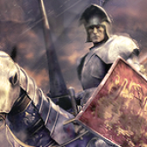
Although all nobles of military age were necessarily knights, knighthood had to be earned through some exploit involving the use of arms. In the late Middle Ages the son of a noble would serve first as page, then as squire, before being made a knight.
Knighthood was conferred by the overlord with the accolade (a blow, usually with the flat of the sword, on the neck or shoulder); in the later period of feudalism, the ceremony was preceded by the religious ceremony of a vigil before an altar.
A knight fighting under another's banner was called a knight bachelor; a knight fighting under his own banner was a knight bannerette.

Slide 13
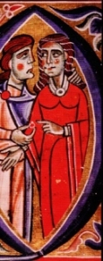
Women in medieval society: no voice, no choice
A woman's place in medieval society was determined by her significant male's standing - either her husband's, father's, or brother's. A man might go off to fight for years in a war and leave his wife in charge of things while he was away, but the moment he returned, she was expected to relinquish power to him, even if she had done a better job of overseeing than he had. When a woman lost her male protector, she often lost her identity and became a social leper.
Choices for women were very limited. A female serf virtually had no choice, since serfs actually belonged to the land on which they lived and worked. These women often worked in the fields just as hard as the men, unless maybe they were busy giving birth or caring for the children. Even women above the class of serfs had few opportunities, pretty much limited to being a maid or servant in the home of a lord or becoming a nun.

Slide 14
Women in medieval Europe had hard lives, even those born to wealthy families. Childbirth was painful, with no medication available to relieve the agony of labor and delivery. Many women died during childbirth or shortly after.
Some bled to death, some incurred serious infections, and others died because their baby could not be delivered because it was too large or turned the wrong way.
Avoiding pregnancy was really not an option. There was little birth control, and women were expected to have children to help work the farms or to serve as heirs to their wealthy husbands.

Slide 15
The rise of the Romance
Medieval times often evoke images of knights battling on muddy fields, dank and dreary castles, hunger, plagues-in general, a lot of rather depressing scenes, but these Dark Ages also witnessed the birth of a romantic movement.
Women in the Middle Ages were usually treated as property. While medieval country marriages were often the result of love, marriage among the noble class was more a business transaction than the culmination of ardent feelings.
But knights returning from the crusades had learned a few things from their adversaries, who revered their women. Passion was considered sinful to 11th and 12th century moralists, but these ideals were slowly being worn away with the rituals of courtly love

