Slide 1
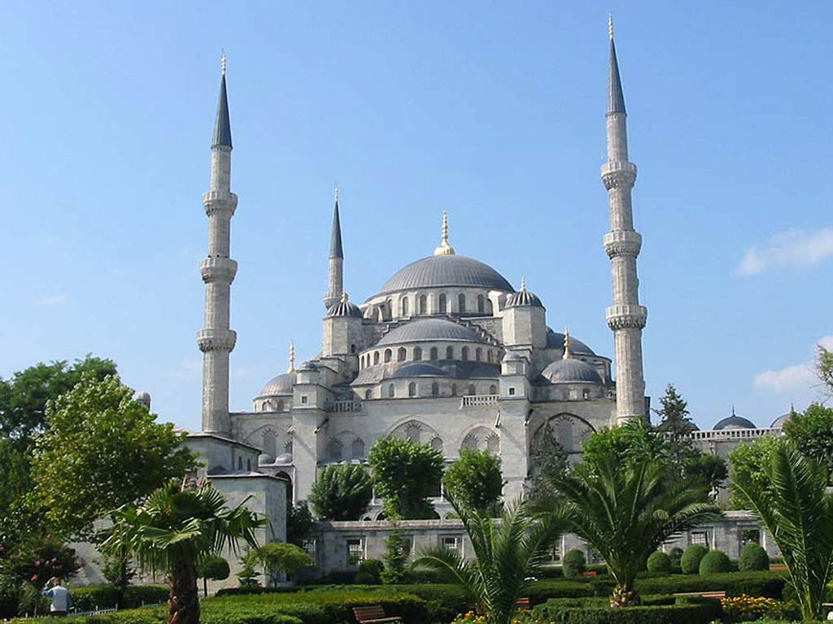
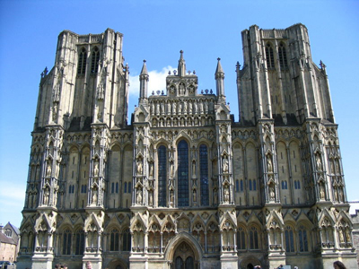
Dar al- Islam vs. Christian Theology
Brie Kordis and Jonathan Lazauskas present:

Slide 2
Religious Divisions
Dar al-Islam: “House of Islam” “House of Submission”
Dar as-Salam: “House of Peace”
Dar al-Tawhid: “House of Union”
Dar al-Harb: “House of War”
Dar al-Kufr: “House of Disbelief”
Dar al-Hunda: “House of Calm”
Dar al- ‘Ahd: “House of Truce”
Dar al-Dawa: “House of Invitation”
Dar al-Amn: “House of Safety”

Slide 3
Dar al-Islam:
Is a geo-political idea that provides assurance of security to all practicing Muslims where they are largely populated.
Is a viewpoint that sees the world as belonging either to Muslims or non-Muslims
Is used to refer to countries where Muslims can practice freely
Is not an idea established in the Qur’an
Is sometimes referred to as Dar al- Salam,

Slide 4
Christian Theology
It’s basically the process of using various scientific tests to show that god exists.
It is also used to help theologians understand Christianity more.
Related to systematic theology, which formulates an orderly belief of Christianity.
Christians were the ones that made it to prove there is a god.
created after the new testament
It was actually inspired by the bible (never saw that coming >.>)
Christian theology breaks down into smaller groups.

Slide 5
Christian theology continued
belief of a supernatural god
based on the bible and the created order
god presented himself generally through creation and the bible
Jesus was also a way god communicated with god’s people
god was then revealed via the creation of the universe
Everyone has a personal god that revealed himself by creating the universe and has a plan for the destiny of that world.

Slide 6
Compare and contrast

Slide 7
Concrete Evidence
Both of these forms of religious dealings are trying to create standard evidence or factual practice to defend their sacred interest.

Slide 8
Umbrella company
Both of these religious thought processes can be broke down into smaller more diverse groups that have a similar general idea but vary on the way they view it and other content. Christian theology breaks off into groups of different thought processes and Dar al-Islam has all the other sub categories of houses just as important as the first.

Slide 9
Documentation
Christian Theology was noted in the bible and thus treated with the same reverence as any other article in their holy book. Although still very sacred, Dar al- Islam was not mentioned in the Qur’an for the begging and was instead adapted later.

Slide 10
Wide scale
Dar al- Islam focuses on a smaller scale dealing with the immediate community of Muslims and views the rest to be a different group, Dar al-Harb. Christian Theology relates their interest to the whole world because they believe everything was influenced by their god.

Slide 11
Questions and Answers

Slide 12
Why is Dar al-islam not mentioned in the Qur’an?
Dar al- Islam (House of Islam) is not mentioned in the Qur’an however, Dar as- Salam(House of Peace) is. Dar as- Salam is the name of paradise that the Qur’an speaks of and assures Muslim followers. Dar al- Islam was a theory and practice that was created later, approximately in the late 13 or early 14 century by the Islamic theologian, logician, and scholar Ibn Taymiyyah.

Slide 13
What does it take for a country to be considered dar al- Islam?
Muslims must be able to enjoy peace and security with and within the country.
The country has common borders with other Muslim countries.
Abu Hanifa is the alleged creator of the requirements for a country to be known for Dar al- Islam.

Slide 14
Why is dar al- Islam sometimes referred to as dar as- salam?
Dar as- Salam and Dar al- Islam although not interchangeable are indeed very similar. They both deal with the idea of freedom and peace. Dar as- Salam is typically associated with paradise as it is called in the Qur’an whereas Dar al-Islam focuses essentially on the freedom of practicing the Muslim religion safely. Both of these try to express a safe haven where Muslims can actively worship.

Slide 15
Why was dar al- Islam established?
Ibn Taymiyyah put Dar al–Islam in the mainstream when he created a religious edict for the protection of Muslims when the Mongols continuously invaded lands where Muslims were predominant in the 13th and 14th centuries.

Slide 16
What is the opposite of dar al- Islam?
The opposite of Dar al–Islam is actually within the group of the other geo-political divisions; Dar al- Harb meaning “The House of War”. This division names the countries that are not under the power of Muslim law and therefore do not have a nonaggression peace treaty with Dar al- Islam and the countries pertaining to it.

Slide 17
Why was god only proven through creation ?
It was the only proof that existed at the time.

Slide 18
Why was Christian theology inspired by the bible?
It is a book of different accounts of ways god presented himself to his people

Slide 19
What test do they use to prove that god exists?
Analyzing, critiquing, and exegesis.

Slide 20
Why are there Christian Theologists?
Because people didn’t quite understand Christianity when it first became a religion and because no one believed in a supernatural god.

Slide 21
What is the importance of religion in community today and why?
Religion isn’t as important as it was back when it first started because people have broken the chains that human feared god and kept them in order, so to speak. But it declined as people began to believe less in god and more in material items.

Slide 22
Works Cited
http://www.google.com/imgres?imgurl=http://lloydi.com/travel-writing/turkey/wallpaper/blue-mosque-1x7.jpg&imgrefurl=http://lloydi.com/travel-writing/turkey/turkey-wallpaper-download.htm&usg=__rbytkLR53nQkLV7SEgwIQPB4gaQ=&h=768&w=1024&sz=97&hl=en&start=0&zoom=1&tbnid=z7Qwb2UXuvohNM:&tbnh=118&tbnw=170&prev=/images%3Fq%3Dmosque%26um%3D1%26hl%3Den%26rlz%3D1T4ADBS_enUS301US301%26biw%3D1269%26bih%3D699%26tbs%3Disch:1&um=1&itbs=1&iact=rc&dur=172&ei=LeSoTIDDAoj0swPN4tieDA&oei=LeSoTIDDAoj0swPN4tieDA&esq=1&page=1&ndsp=27&ved=1t:429,r:2,s:0&tx=173&ty=83
http://www.ship-of-fools.com/mystery/2006/1324.html
http://www.mideastweb.org/Middle-East-Encyclopedia/dar-al-islam.htm
http://en.wikipedia.org/wiki/Divisions_of_the_world_in_Islam#Dar_al-Islam
http://en.wikipedia.org/wiki/Christian_theology
http://www.allaboutworldview.org/christian-theology.htm

