Slide 1
God is Dead From “The Death of God” Lecture
Friedrich Nietzche’s Statement:
Jessica Manno and EDM

Slide 2
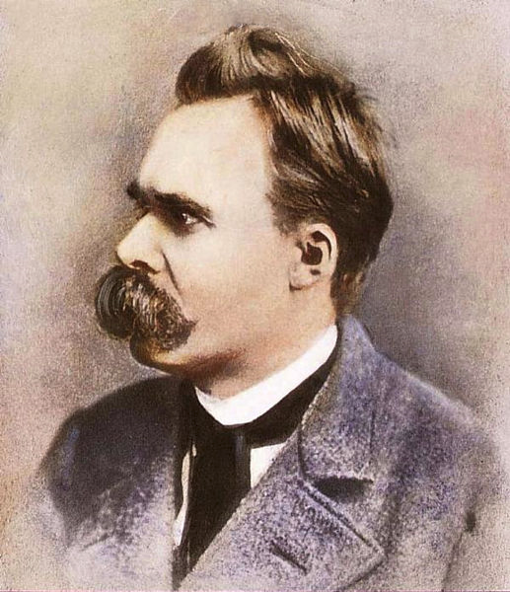
Who is Friedrich Nietzsche?
19th century German philosopher, poet and classical philologist
Believed the material things in the world were doing okay for us, so pronounced God to be dead (God was not needed)
Believed godly roles were already done by humans
“God is dead. God remains dead. And we have killed him.”

Slide 3
Nietzsche’s Idea:
“God is dead. God remains dead. And we have killed him. How shall we comfort ourselves, the murderers of all murderers? What was holiest and mightiest of all that the world has yet owned has bled to death under our knives: who will wipe this blood off us? What water is there for us to clean ourselves? What festivals of atonement, what sacred games shall we have to invent? Is not the greatness of this deed too great for us? Must we ourselves not become gods simply to appear worthy of it?”
—Nietzsche, The Gay Science, Section 125, tr.

Slide 4
Analysis
The death of God is a way of saying that humans are no longer able to believe in any such cosmic order since they themselves no longer recognize it. The death of God will lead, Nietzsche says, not only to the rejection of a belief of cosmic or physical order but also to a rejection of absolute values themselves — to the rejection of belief in an objective and universal moral law, binding upon all individuals. In this manner, the loss of an absolute basis for morality leads to nihilism.

Slide 5
Analysis
Nietzsche believed that the majority of people did not recognize this death out of the deepest-seated fear or angst. Therefore, when the death did begin to become widely acknowledged, people would despair and nihilism would become rampant. This is partly why Nietzsche saw Christianity as nihilistic.

Slide 6
Further Analysis -Misunderstandings
When first being introduced to Nietzsche’s concept of the death of God, it’s easy for a person to infer the “death of God” in a literal sense. The concept of God only exists in the minds and beliefs of his followers; therefore, the believers would ultimately be accountable for his life and death. Holub goes on to state that “God has been the victim of murder, and we, as human beings, are the murderers”

Slide 7
Further Analysis -Misunderstandings
Another purpose of Nietzsche’s death of God is to “unmask the hypocrisies and illusion of outworn value systems” (Pfeffer 18).
Nietzsche believed that man was useless without a God and “no longer possesses ideals and absolute goals toward which to strive. He has lost all direction and purpose” (Pfeffer 76)

Slide 8
Conclusion
Nietzsche believed there could be positive possibilities for humans without God. Relinquishing the belief in God opens the way for human creative abilities to fully develop. The Christian God, he wrote, would no longer stand in the way, so human beings might stop turning their eyes toward a supernatural realm and begin to acknowledge the value of this world.

Slide 9
Conclusion
Nietzsche uses the metaphor of an open sea, which can be both exhilarating and terrifying. The people who eventually learn to create their lives anew will represent a new stage in human existence, the Übermensch — i.e. the personal archetype who, through the conquest of their own nihilism, themselves become a sort of mythical hero. The 'death of God' is the motivation for Nietzsche's last (uncompleted) philosophical project, the 'revaluation of all values'.

Slide 11
Paraphrase this PowerPoint
Slide 3

Slide 12
Paraphrase this PowerPoint
Slides 4-5

Slide 13
Paraphrase this PowerPoint
Slides 6-7

Slide 14
Paraphrase this PowerPoint
Slides 8-9

Slide 15
Historical Evidence
Provide 5 bullets of historical evidence (with WHC, please) which proves or disproves statement Friedrich Nietzsche’s statement.
-
-
-
-
-

