Slide 1
Georges Danton
By Katlin Boyd

Slide 2
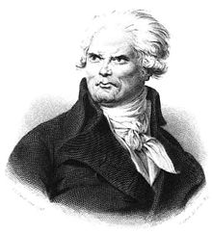
When and Where was he born?
Danton was born the 26th of October, in Arcis-sur-Aube in northeastern France.
1759 – 5 April 1794

Slide 3
What was his family like?
His parents Jacques Danton and Mary Camus, came from a respectable, but not a wealthy family. He was given a good education then he became an Advocate in Paris.

Slide 4
Who was his own family?
He married Antoinette Charpentier in 1787. Then had three sons.

Slide 5
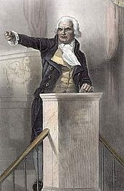
What was Danton like?
According to a biographer, "Danton's height was colossal, his make athletic, his features strongly marked, coarse, and displeasing; his voice shook the domes of the halls“.

Slide 6
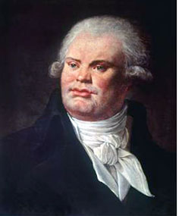
How did he start out?..
He first appears in the revolutionary story as president of the popular club or assembly of the district in which he lived.

Slide 7
-And then what?
Danton was involved in the storming of the Bastille and for the move of the King's court, from Versailles to the Tuileries. In 1790, he became president of the "Cordeliers" club, with Marat and Camille Desmoulins.

Slide 8
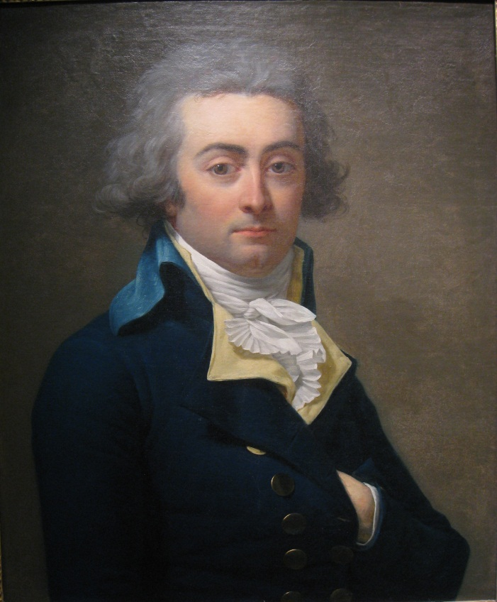
After that . . .
In July1791 he was elected administrator of Paris. After the Champ de Mars massacre on July 17th, 1791 the people questioned the constitutional party and Danton had to move to England. Back in Paris in November, he was elected "Procureur de la communes de Paris".

Slide 9
What happens in 1792?
Danton gained a lot of power
The people of Paris stormed the Tuileries following the King's failed attempt to escape and soon after, be became Minister of Justice .
He was elected Deputy of Paris on September 5th.

Slide 10
The Downfall . . .
He was accused of being too soft by counter revolutionaries. Georges was fired from the "Comite de Salut public" and Robespierre took his place.
On March 30th, 1794, Danton was arrested. He was accused by the revolutionaries court of being an enemy of the Republique. He was killed on April 5th, 1794. Danton’s last words were "Do not forget to show my head to the people, it is well worth seeing".

