Slide 1
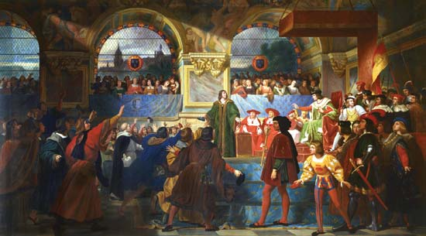
Estates-General
Aminah Bishop
1B

Slide 2
What is Estates-General?
Estates was a legislative assembly of the different classes of French subjects.
Estates General was a representative body drawn from the three ‘estates’ into which society had been theoretically divided: the First Estate was comprised of the clergy, the Second Estate the nobility, and the Third Estate everyone else. The Third Estate was a vastly larger proportion of the population than the other two estates, but in the early Estates General they only had as much say as the other two estates had each.

Slide 3
Who created the Estates?
King Louis XVI was forced to agree to the calling of the States-General. Elections were ordered in 1788, and on May 5, 1789, for the first time since 1614, the States-Genera met at Versailles. The chief purpose of the king and of Necker, who had been recalled, was to obtain the assembly's consent to a general fiscal reform.

Slide 4
About estates-general
The Estates-General sat for several weeks in May and June of 1789, but came to an impasse as the three Estates clashed over their respective powers. It was brought to an end when many members of the Third Estate formed themselves into a National assembly, signaling the outbreak of the French Revolution.

Slide 5
Facts
In France of the pre-Revolutionary monarchy, the representative assembly of the three “estates,” or orders of the realm: the clergy and nobility—which were privileged minorities—and a Third Estate, which represented the majority of the people.

Slide 6
Facts
The Third Estate was made up of all those who were neither nobles nor clergymen (ie about 95% of the population) and in each region or major town, an electorate based on limited suffrage voted representatives from among the local notables.

Slide 7
Third
When the Estates-General met there was an immediate problem because the estates were supposed to debate issues separately and vote by estate. This would mean that as long as the nobles and the church could vote together, the 3rd Estate could never veto. This was especially important because the 3rd Estate numbered twice as many representatives as each of the other two estates. There had been much debate in the run-up to the opening of the estates and this question of whether the votes would be by order or by individual had been hotly debated without any resolution.

Slide 8
Why was the estates called?
In 1789, Louis XVI’s government was about to go bankrupt. In desperation, Louis sought to raise taxes. He called the Estates-general into session.

Slide 9
National Assembly
On June 17, 1789, one month after the Estates-General met at Versailles, the members of the third estates declared themselves to be the `National Assembly', since they represented at least 96% of the nation. They took monarch powers in respect of taxation and decided to frame a constitution restricting the powers of the king

Slide 10
Facts
The clergy and the nobles had dominated the Estates-General throughout the Middle Ages and expected to do so in the 1789 meeting. Under the assembly’s medieval rules, each estate’s delegate's met in a separate hall to vote, and each estate had one vote. The two privileged estates could always outvote the Third Estate.

