Slide 1
Haitian Slave revolution & Roman slave Rebellion
Compare & Contrast

Slide 2
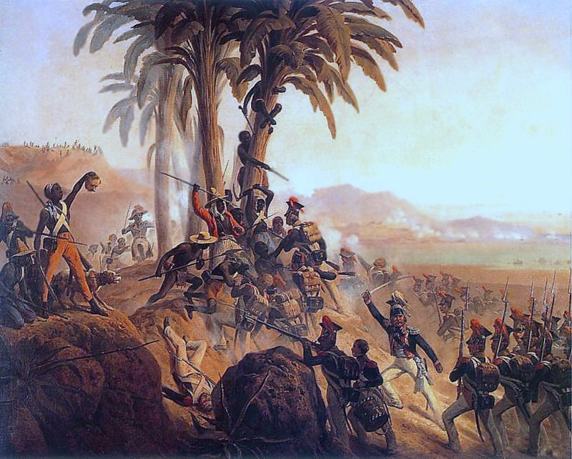
Over view for Haitian rebellion:
What: Haitian slave rebellion
When: 1791-1804 (14 Aug.-18 Nov. 1803)
Where: Saint Domingue
Result: Haitian Victory!
Territorial: Expulsion of the French colonial.
Changes: Government establishment of the independent republic of Haiti.

Slide 3
Continued…
The rebellion was a struggle & brutal conflict in the French colony of Saint Domingue, leading to the termination of slavery!! Which established Haiti being the first republic ruled by people of African ancestry.

Slide 4
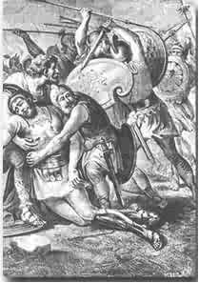
Over view for Roman slave rebellion (Spartacus)
Who: Belligerents; Army of escaped slaves. & Roman army
What: Roman slave rebellion / The third servile war
When: 73-71 B.C
Where: Italy
Result: Decisive Roman victory

Slide 5
Continued…
The slaves were escaped gladiators and other forms of lower classes in Europe, the strength of the slaves was; 120,000 escaped slaves & gladiators, including non-combatants.
Roman soldiers strength; 3,000 + Militia = 8 roman legions (40,000-50,000 men)
Spartacus was the main leader of the slaves and he led them to many victories of battles but the Romans became to strong and over powered them.

Slide 6
Comparing the two rebellions/revolutions
Both Involved SLAVES.
Both of them went through stage three of Britons theory: 1.Radicals Take Control 2.Moderates Driven From Power 3.Civil War 4.Foreign War 5.Centralization of Power in a Revolutionary Council Dominated by a Strong Man.
Both rebellions had tyrannical rulers.

Slide 7
Contrasting the two rebellions/revolutions
With reading the Briton revolution paper, I would say that the Haitian rebellion made it all the way to the last stage in the process of revolution.
The roman rebellion made it to about the 3rd stage of the crisis stage, due to the flourishing power of the Romans.
The Haitian rebellion conquered and took over, making it better.
Roman Rebellion failed and Romans took back over the land.
The Roman rebellion was in the late past around 71-73 B.C
The Haitian rebellion was in the later 1700’s to the early 1800’s

Slide 8
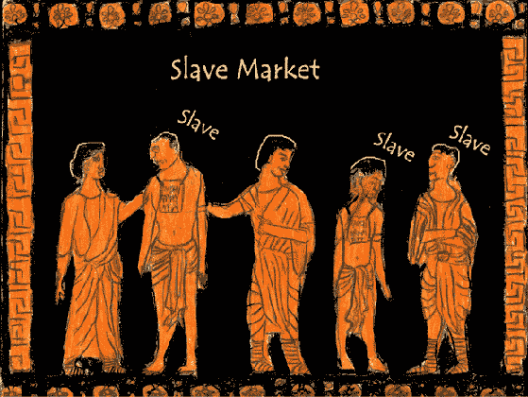
Cites
http://demott.weebly.com/uploads/5/1/2/7/5127112/crane20brinton.pdf
http://en.wikipedia.org/wiki/Haitian_Revolution
http://en.wikipedia.org/wiki/Sparticus

