Slide 1
Absolutism
Patrick Stascavage

Slide 2
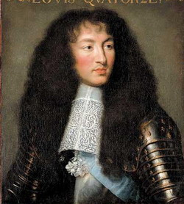
What is it?
Absolutism is where a king declares himself king through the divine right, and has supreme power over the state. A few good example of this is King Louis XIV.

Slide 3
King Louis XIV
Probably one of the most remarkable absolutists of the seventeenth century. His rule reigned for 72 Years! 54 of those years he controlled the French government. According to historians, this is the best example in all of history of absolutism.

Slide 4
His Army
King Louis had a massive army of 300,000 soldiers. This entire army was paid for, fed, and trained by the state. King Louis used this massive army to protect France, but also enforce his policies locally and in foreign places.

Slide 5
Supreme Power
King Louis controlled it all. He made all the laws by himself and never, in his entire reign had to call together the Estates Generals, which was basically a group of people who checked the king, kind of like how Congress and our system of checks and balances. He was so powerful, he held ceremonies daily in celebration of his power, and every morning started with something called “la levee”, which is the kings rising. This was a huge court occasion.

Slide 6
The Nobles
Only the most well known nobles can attend these particular events. Then it could only be men in the mornings. At night time a similar party is thrown except that the women could go this time. These nobles were a threat to the king. They were descendants of the feudal lords. They still had power over there estates. So the king lured them to the parties making them into allies rather than enemies, and gaining there support.

Slide 7
Expansion
King Louis used many, many resources into attempts to expand France’s borders. At first, he was successful and expanded his territory. Then his enemies teamed up and pushed back, making his later attempts to expand absolutely horrible. Another big blunder that happened on his be-half was the persecution of Huguenots. They were the labor force of France. After about 100,000 of them left France

Slide 8
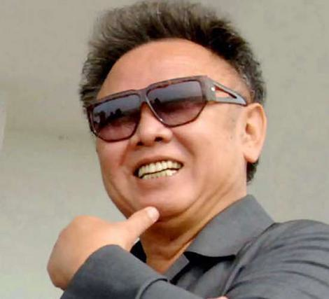
Kim Jong
Kim Jong, currently the dictator of North Korea, is the dictator who I believe has the most in common with King Louis XIV. They both have had extremely long rules and had an extremely powerful army.

Slide 9
About Him
Kim Jong is a very short man (5’3”0. he has a passion for the cinema. It is said that he has over 20,00 Hollywood videos in his collection. He has written a book on cinema and has even devised a plan to kidnap a very famous South Korean movie star along with his girlfriend. Kim is known for being a drinker. Once he was seen drinking ten glasses of wine.

Slide 10
Ascent to Power
In 1968, Kim Jong joined the Communist party. A year later, he ascended to the job of deputy director. In 1980, he was elected to the secretary of the Central Committee. The date was 1991, Kim Jong is appointed to be the head of armed forces. The next year it was made known he was in charge of anything internal also.

Slide 11
Priorities
North Koreas most important priority is their military. According to their GDP this is where quite a large chunk of their money is spent. In fact they want military power so much they announced in 2005 they currently have nuclear technology. They have been using the threat of developing nuclear technology for many years as a bargaining chip.

Slide 12
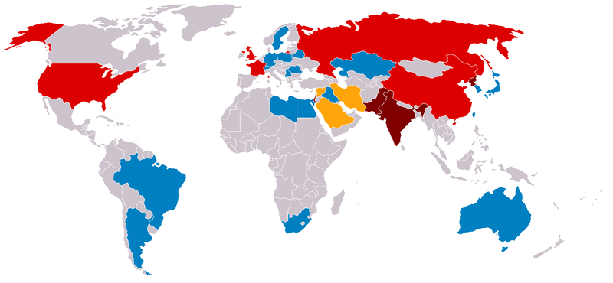
Red countries do have nukes, but agreed to the treaties restraining their usage. The dark red countries did not agree to it. Orange countries are those under suspicion of having nuclear weapons. Those in blue or gray do not or don’t anymore own nukes.

Slide 13
http://ezinearticles.com/?What-is-Absolutism?&id=436269
http://www.louis-xiv.de/
http://news.bbc.co.uk/2/hi/asia-pacific/1907197.stm
http://www.dictatorofthemonth.com/Il/Jul2005IlEN.htm

